Slide 1
Connecting the Upper Mantle to Volcanoes in the Western United States
Joseph S. Byrnes¹
with James Gaherty^{1,2}, Emily Hopper², and Ryan Porter¹
¹ Northern Arizona University
² Lamont-Doherty Earth Observatory

Slide 2
Brief bio
- PhD at the University of Oregon
- Emilie Hooft and Doug Toomey – Marine Seismology
Two post-docs
- Minnesota with Max Bezada – Continental Seismology
- Northern Arizona with Jim Gaherty - Both marine and continental
- Now Research Professor at NAU

Slide 3
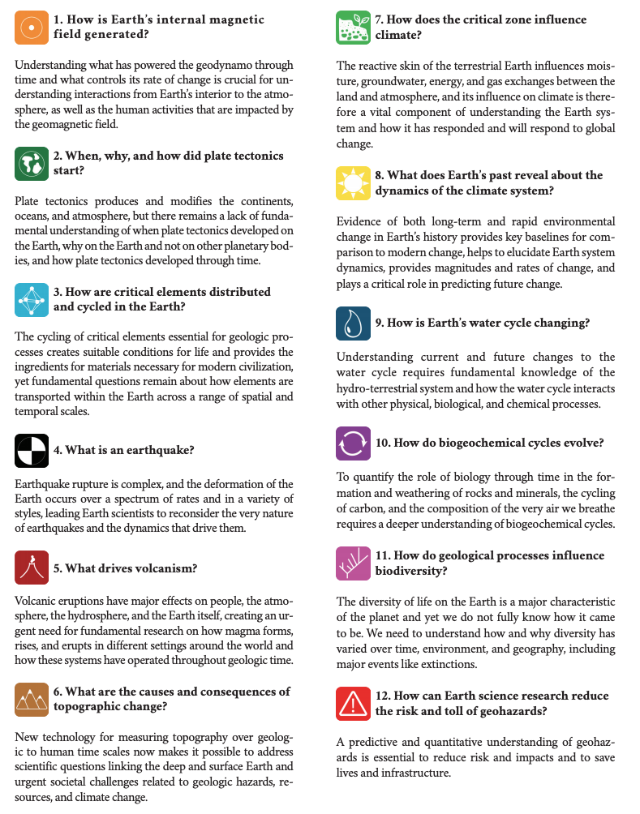
Brief bio
- PhD at the University of Oregon
- Emilie Hooft and Doug Toomey
Two post-docs
- Minnesota with Max Bezada
- Northern Arizona with Jim Gaherty
- Now Research Professor at NAU
National Academy of Science Priority Science questions for 2020-2030
“5. What drives volcanism?”

Slide 4
Brief bio
- PhD at the University of Oregon
- Emilie Hooft and Doug Toomey
Two post-docs
- Minnesota with Max Bezada
- Northern Arizona with Jim Gaherty
- Now Research Professor at NAU
National Academy of Science Priority Science questions for 2020-2030
“5. What drives volcanism?”
My focus: mantle roots of volcanism

Slide 5
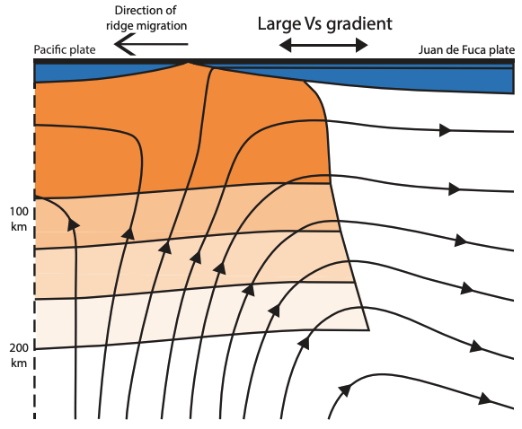
“5. What drives volcanism?”
Patterns of mantle flow
beneath volcanic systems
Byrnes et al., 2017

Slide 6
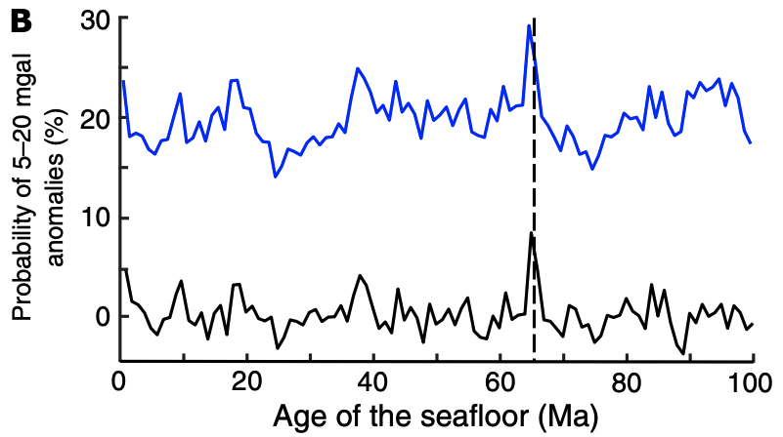
“5. What drives volcanism?”
Patterns of mantle flow
beneath volcanic systems
Triggering of volcanic eruptions
(here, by the Chicxulub impact)
Byrnes and Karlstrom, 2018
Byrnes et al., 2017

Slide 7
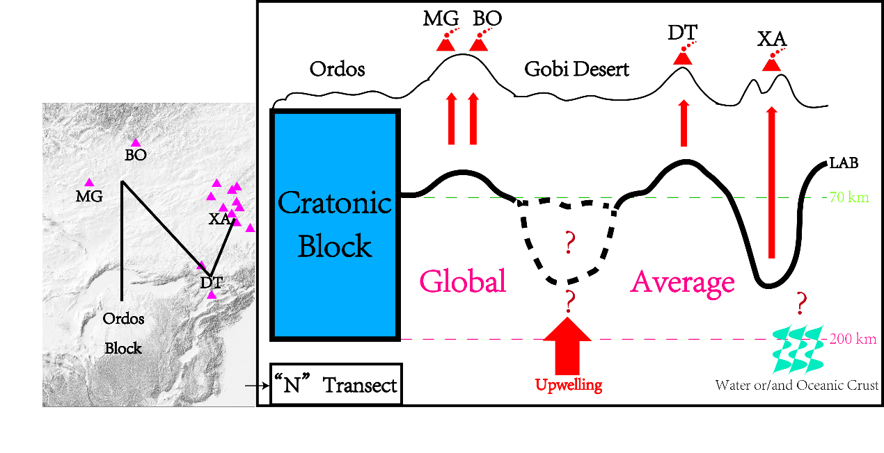
“5. What drives volcanism?”
Byrnes and Karlstrom, 2018
Triggering of volcanic eruptions
(here, by the Chicxulub impact)
Patterns of mantle flow
beneath volcanic systems
Physical State of the mantle beneath volcanos
focus of this talk
Byrnes et al., 2017
Byrnes and Karlstrom, 2018
Hanlin et al., 2022

Slide 8
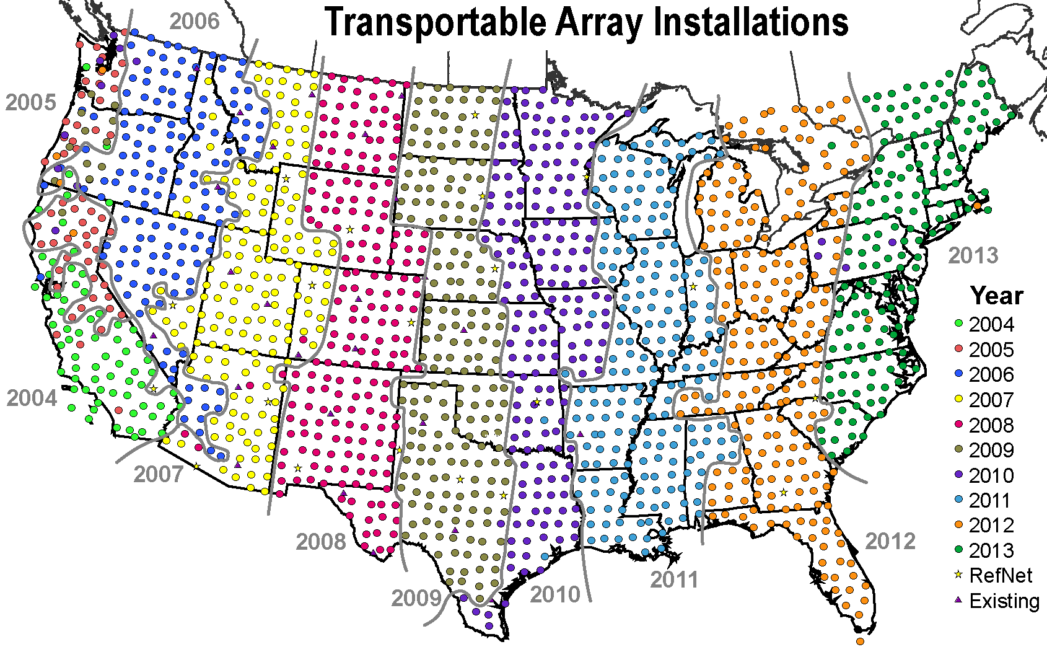
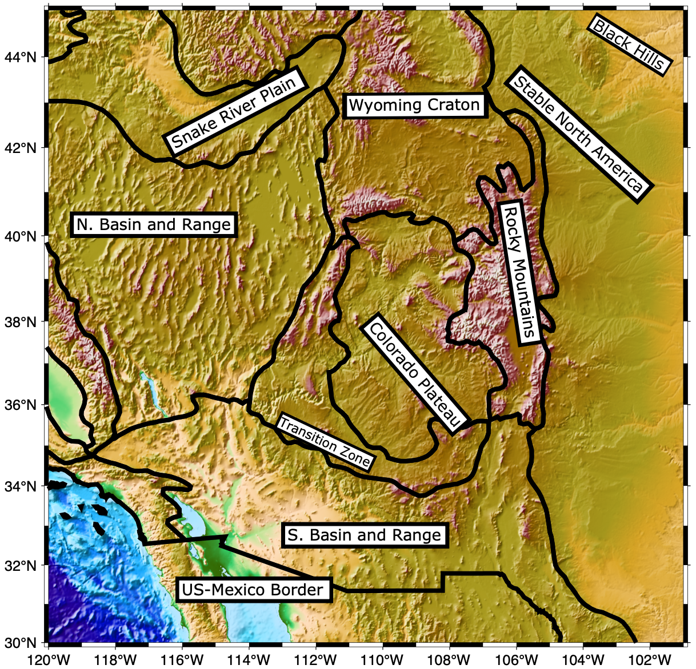
Imaging of the Western United States; Byrnes et al., 2023 in Seismica

Slide 9
Joseph yrnes – Louisiana State University
Imaging of the Western United States; Byrnes et al., 2023 in Seismica
Focus on the Colorado Plateau, Rio Grand Rift,
Basin and Range, Snake River Plain, and some
of the Wyoming Craton
Summary at the outset:
Melt present in the upper asthenosphere beneath
almost all recent volcanism in the region

Slide 10
Joseph yrnes – Louisiana State University
Imaging of the Western United States; Byrnes et al., 2023 in Seismica
Summary at the outset:
Melt present in the upper asthenosphere beneath
almost all recent volcanism in the region
Structures that don’t fit into our parameterization
Transform fault and subduction
Stable continent - return to at the end of the talk
Much less data

Slide 11
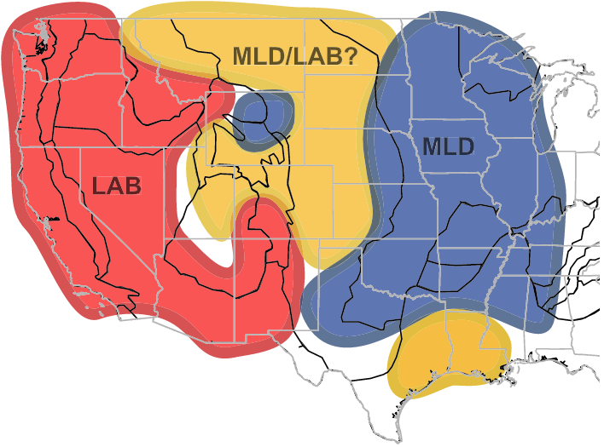
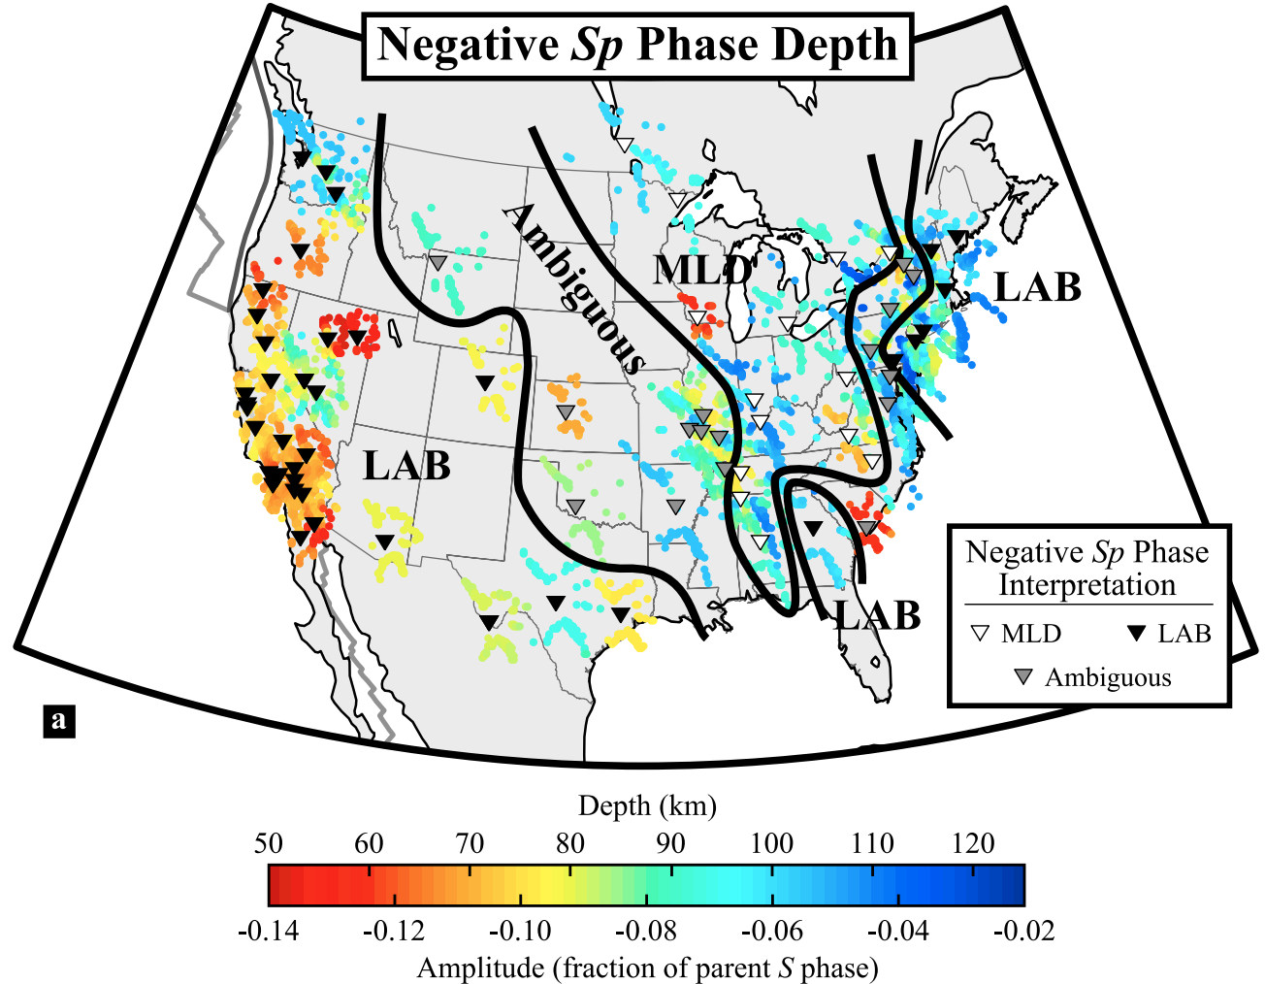
Physical state of the upper mantle in the western United States
- How thick is the lithosphere?
- How is the distribution of volcanism related to hot asthenosphere?
- Where is there melt in the asthenosphere?
LAB – lithosphere asthenosphere boundary
MLD – mid-lithospheric discontinuity
Abt et al., 2010
Hansen et al., 2015

Slide 12
Physical state of the upper mantle in the western United States
- How thick is the lithosphere?
- How is the distribution of volcanism related to hot asthenosphere?
- Where is there melt in the asthenosphere?
Fischer et al., 2010
Hansen et al., 2015

Slide 13
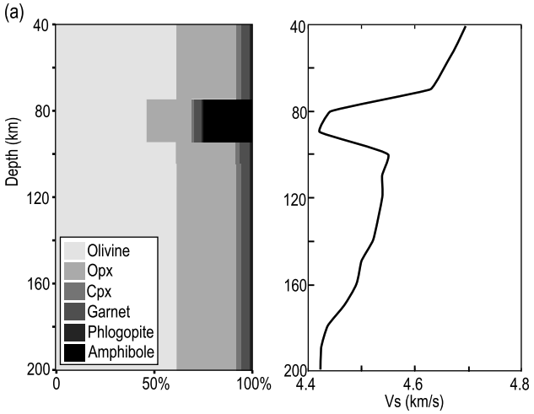
Physical state of the upper mantle in the western United States
- How thick is the lithosphere? Has the lithosphere been metasomatized?
- How is the distribution of volcanism related to hot asthenosphere?
- Where is there melt in the asthenosphere?
Different hypotheses for the “MLD”
Selway et al, 2015
Hansen et al., 2015

Slide 14
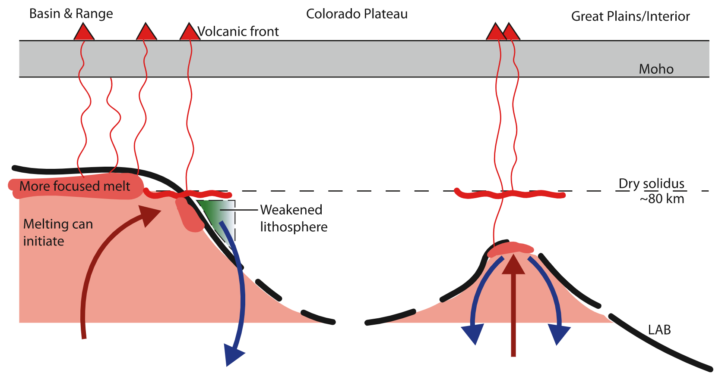
Physical state of the upper mantle in the western United States
- How thick is the lithosphere?
- How is the distribution of volcanism related to hot asthenosphere?
- Where is there melt in the asthenosphere?
Golos et al., 2022

Slide 15
Physical state of the upper mantle in the western United States
- How thick is the lithosphere?
- How is the distribution of volcanism related to hot asthenosphere?
- Where is there melt in the asthenosphere?
Golos et al., 2022

Slide 16
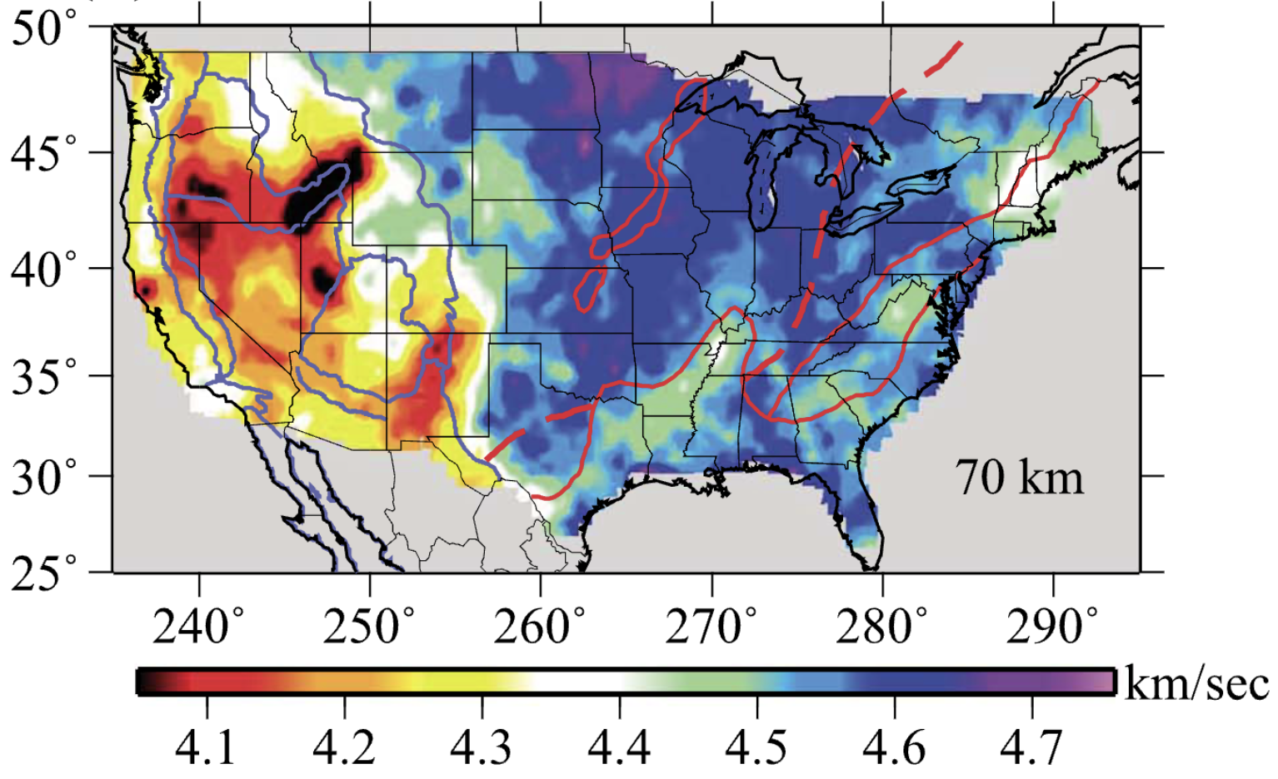
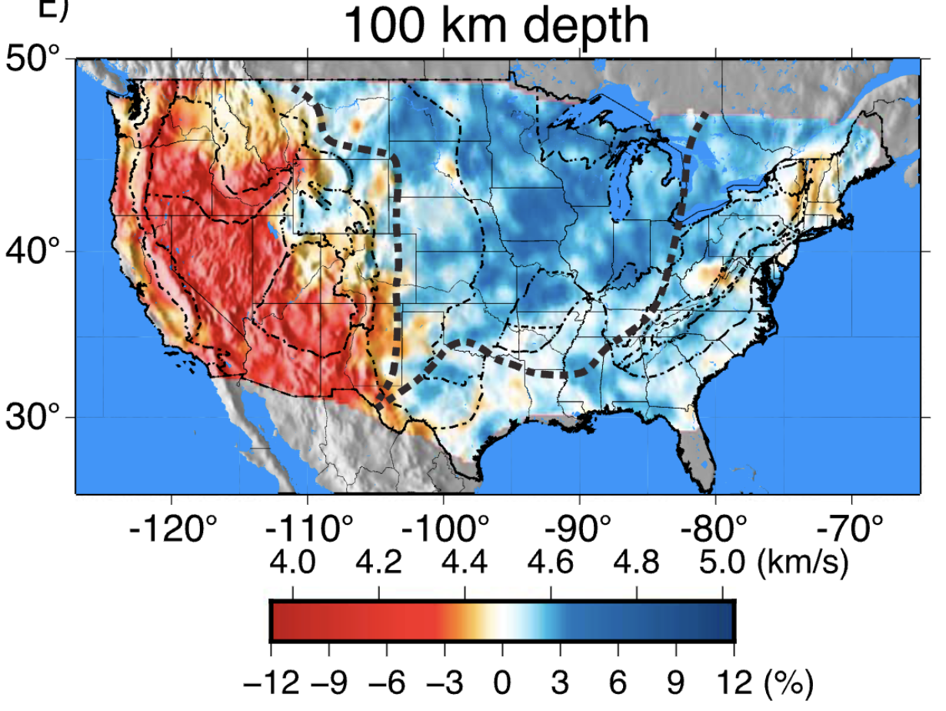
Physical state of the upper mantle in the western United States
- How thick is the lithosphere?
- How is the distribution of volcanism related to hot asthenosphere?
- Where is there melt in the asthenosphere?
Shen and Ritzwoller, 2016
Porter et al., 2016

Slide 17
Physical state of the upper mantle in the western United States
- How thick is the lithosphere?
- How is the distribution of volcanism related to hot asthenosphere?
- Where is there melt in the asthenosphere?
Shen and Ritzwoller, 2016
Porter et al., 2016

Slide 18
Physical state of the upper mantle in the western United States
- How thick is the lithosphere?
- How is the distribution of volcanism related to hot asthenosphere?
- Where is there melt in the asthenosphere?
Shen and Ritzwoller, 2016
Porter et al., 2016

Slide 19
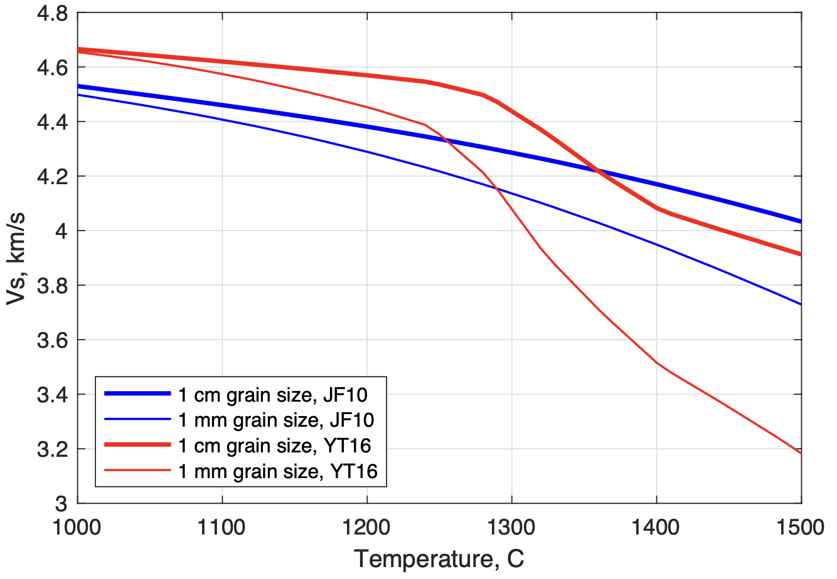
Physical state of the upper mantle in the western United States
- How thick is the lithosphere?
- How is the distribution of volcanism related to hot asthenosphere?
- Where is there melt in the asthenosphere?
~4.1 km/s is not that slow! Temperatures could be low enough to prevent melting

Slide 20
Physical state of the upper mantle in the western United States
- How thick is the lithosphere?
- How is the distribution of volcanism related to hot asthenosphere?
- Where is there melt in the asthenosphere?
~4.1 km/s is not that slow! Temperatures could be low enough to prevent melting
Jackson and Faul, 2010
Boston University and ANU groups
Measured seismic velocities directly on olivine
under *partially* realistic conditions.
Discovered a poorly resolved relaxation
mechanism at higher temperatures

Slide 21
Physical state of the upper mantle in the western United States
- How thick is the lithosphere?
- How is the distribution of volcanism related to hot asthenosphere?
- Where is there melt in the asthenosphere?
~4.1 km/s is not that slow! Temperatures could be low enough to prevent melting
Yamauchi and Takei et al., 2016
University of Tokyo
Measurements on an organic analogue for
olivine and documented a “premelting” effect
that reduces the velocities before magma
is generated

Slide 22
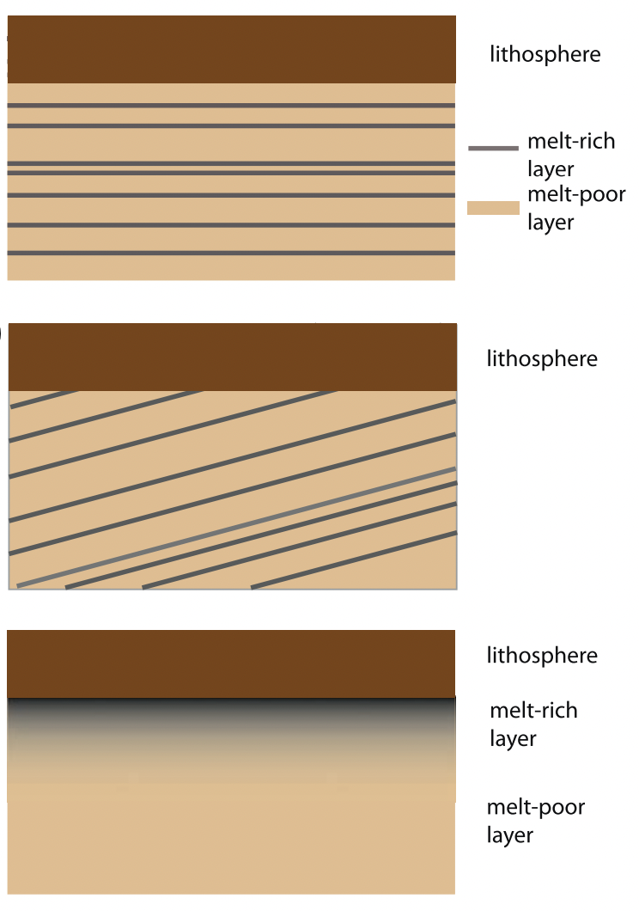
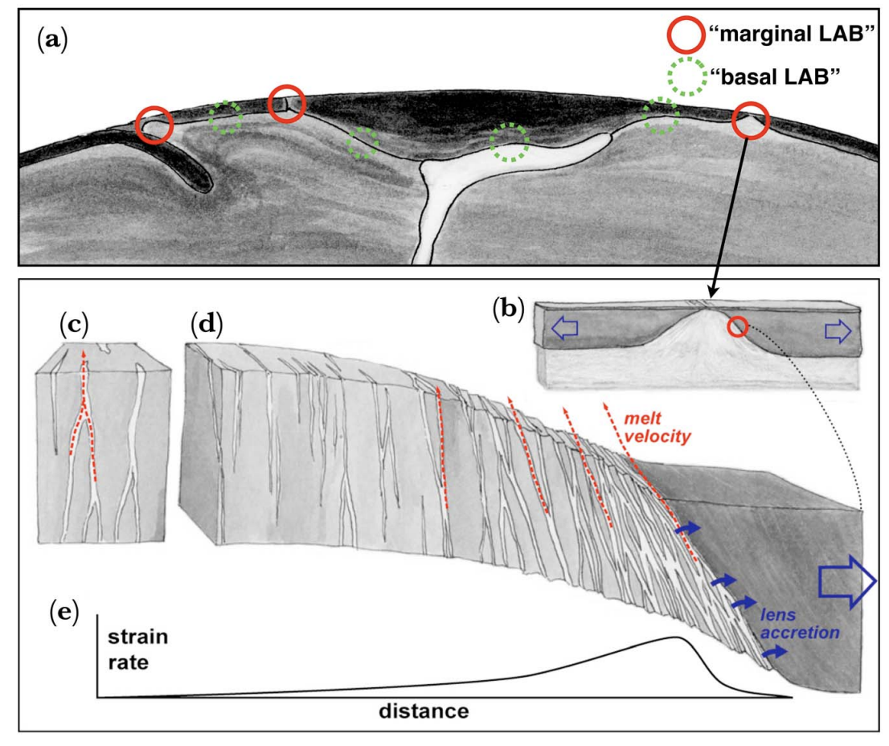
Physical state of the upper mantle in the western United States
- How thick is the lithosphere?
- How is the distribution of volcanism related to hot asthenosphere?
- Where is there melt in the asthenosphere?
Holtzman and Kendall, 2010
Karato, 2013
rejects all three
as geodynamically
implausible

Slide 23
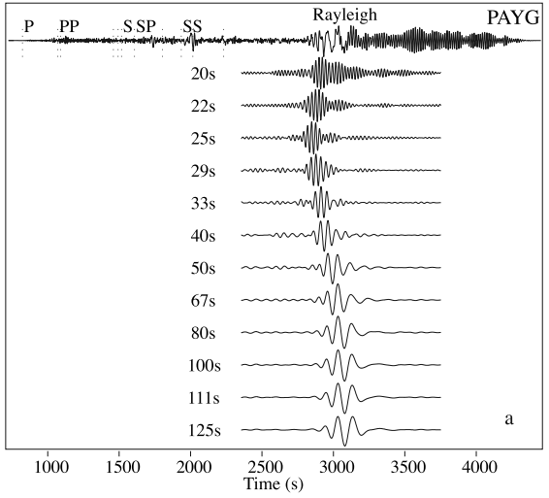
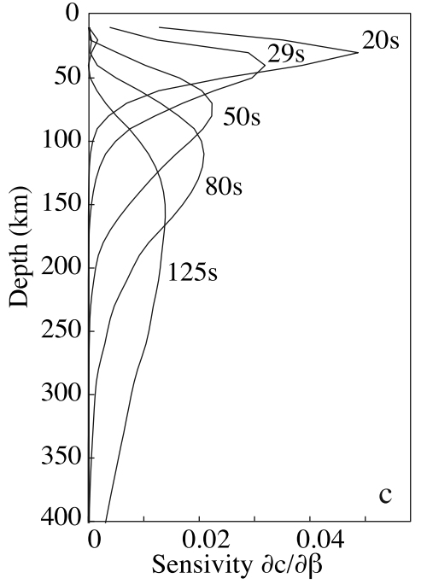
Methodology – a new velocity model tuned to this problem
Previous results that I’ve shown used one of two datasets for the mantle – velocities of surface waves or Sp receiver functions
- Surface waves give smooth models, and receiver functions only give relative seismic properties.
Villagomez et al., 2007

Slide 24
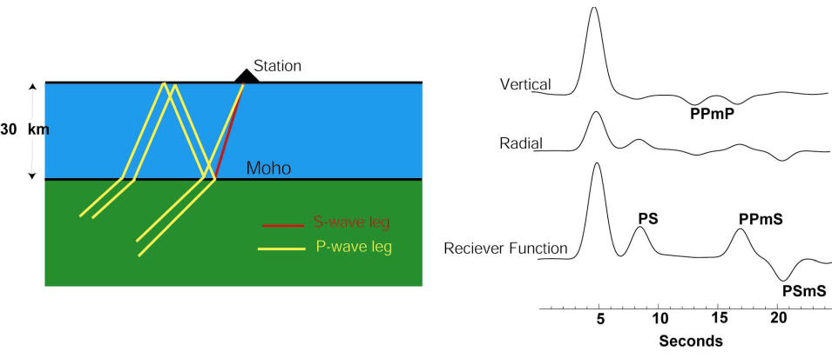
Methodology – a new velocity model tuned to this problem
Previous results that I’ve shown used one of two datasets for the mantle – velocities of surface waves or Sp receiver functions
- Surface waves give smooth models, and receiver functions only give relative seismic properties.
Amplitude scales with
the change in velocity
Timing scales with depth
https://ds.iris.edu/media/workshop/2013/01/advanced-studies-institute-on-seismological-research/files/lecture_introrecf.pdf

Slide 25
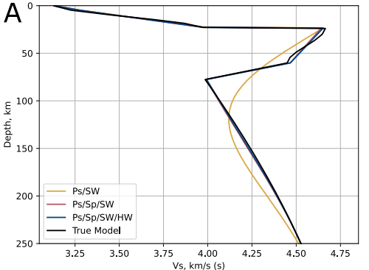
Methodology – a new velocity model tuned to this problem
Previous results that I’ve shown used one of two datasets for the mantle – velocities of surface waves or Sp receiver functions
- Surface waves give smooth models, and receiver functions only give relative seismic properties.
This project jointly inverts for absolute seismic velocities with discontinuities constrained by receiver functions
Input test model
Simulated LAB
Recovered model
with surface waves
only

Slide 26
Methodology – a new velocity model tuned to this problem
Previous results that I’ve shown used one of two datasets for the mantle – velocities of surface waves or Sp receiver functions
- Surface waves give smooth models, and receiver functions only give relative seismic properties.
This project jointly inverts for absolute seismic velocities with discontinuities constrained by receiver functions
Input test model
Simulated LAB
Recovered model
from joint
inversion

Slide 27
Methodology – a new velocity model tuned to this problem
Previous results that I’ve shown used one of two datasets for the mantle – velocities of surface waves or Sp receiver functions
- Surface waves give smooth models, and receiver functions only give relative seismic properties.
This project jointly inverts for absolute seismic velocities with discontinuities constrained by receiver functions
4 data sets in all
Rayleigh wave phase
velocities

Slide 28
Methodology – a new velocity model tuned to this problem
Previous results that I’ve shown used one of two datasets for the mantle – velocities of surface waves or Sp receiver functions
- Surface waves give smooth models, and receiver functions only give relative seismic properties.
This project jointly inverts for absolute seismic velocities with discontinuities constrained by receiver functions
4 data sets in all
Rayleigh wave phase
velocities
P to s receiver function

Slide 29
Methodology – a new velocity model tuned to this problem
Previous results that I’ve shown used one of two datasets for the mantle – velocities of surface waves or Sp receiver functions
- Surface waves give smooth models, and receiver functions only give relative seismic properties.
This project jointly inverts for absolute seismic velocities with discontinuities constrained by receiver functions
4 data sets in all
Rayleigh wave phase
velocities
P to s receiver functions
S to p receiver functions

Slide 30
Methodology – a new velocity model tuned to this problem
Previous results that I’ve shown used one of two datasets for the mantle – velocities of surface waves or Sp receiver functions
- Surface waves give smooth models, and receiver functions only give relative seismic properties.
This project jointly inverts for absolute seismic velocities with discontinuities constrained by receiver functions
4 data sets in all
Rayleigh wave phase
velocities
P to s receiver functions
S to p receiver functions
Pn velocities

Slide 31
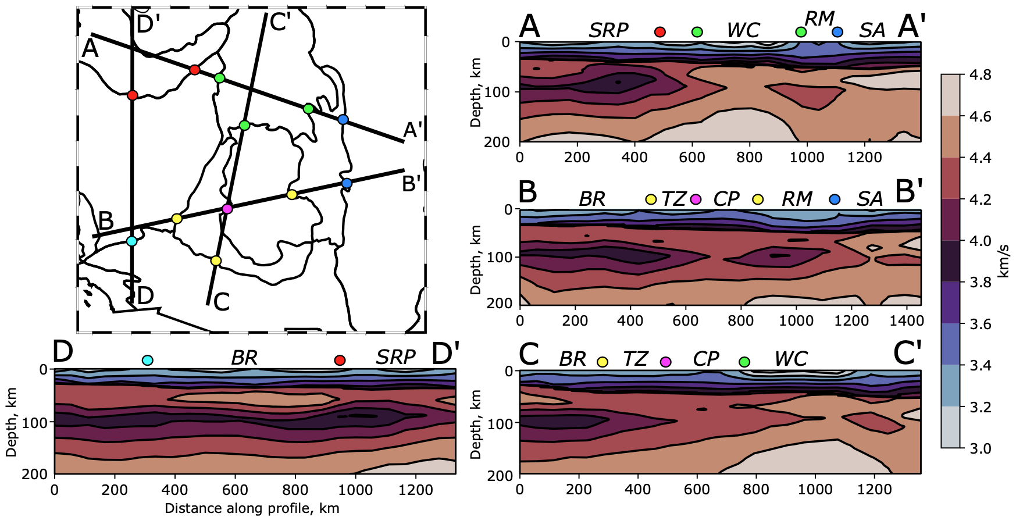
Pattern in velocity below the “LAB(?)”
Depth slices through the model

Slide 32
Pattern in velocity below the “LAB(?)”
Consistent low velocities beneath the entire Basin and Range Province, which cross into the Colorado Plateau
Depth slices through the model

Slide 33
Pattern in velocity below the “LAB(?)”
Higher velocities to the east of the Rockies mountains and in Wyoming
Depth slices through the model

Slide 34
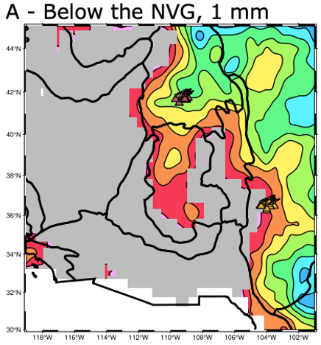
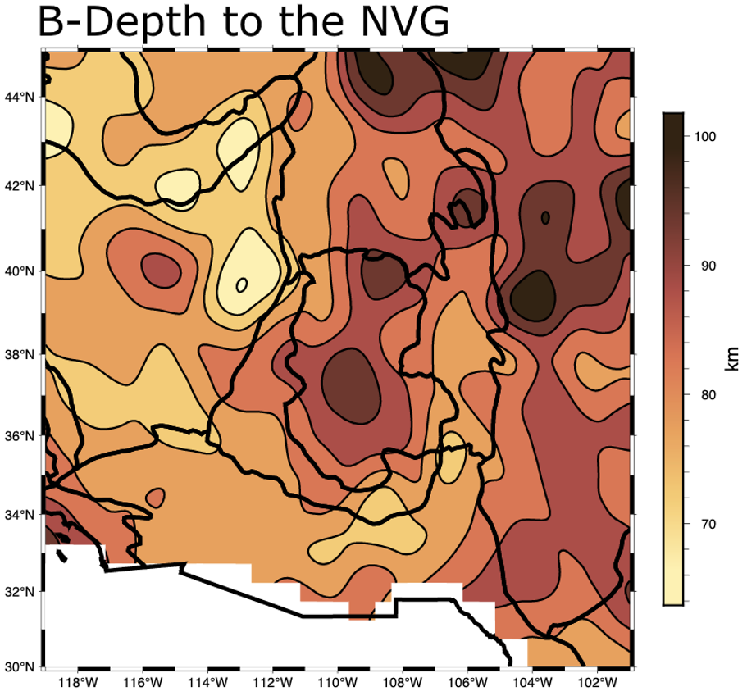
- How thick is the lithosphere?
Depth to the NVG
Region of
MLDs
~<1200 C is unlikely
to be “asthenosphere”
Extremely high
temperature
required

Slide 35
- Where is there melt in the asthenosphere?
Used the Very Broadband Rheology Calculator (Havlin et all., 2021) to test the hypothesis that Vs below the NVG can be
explained by 1)temperature 2) grain size using priors based on basalt thermobarometers and xenolith data.
Two different predictions for Vs from experimental data give 95% confidence intervals shown below

Slide 36
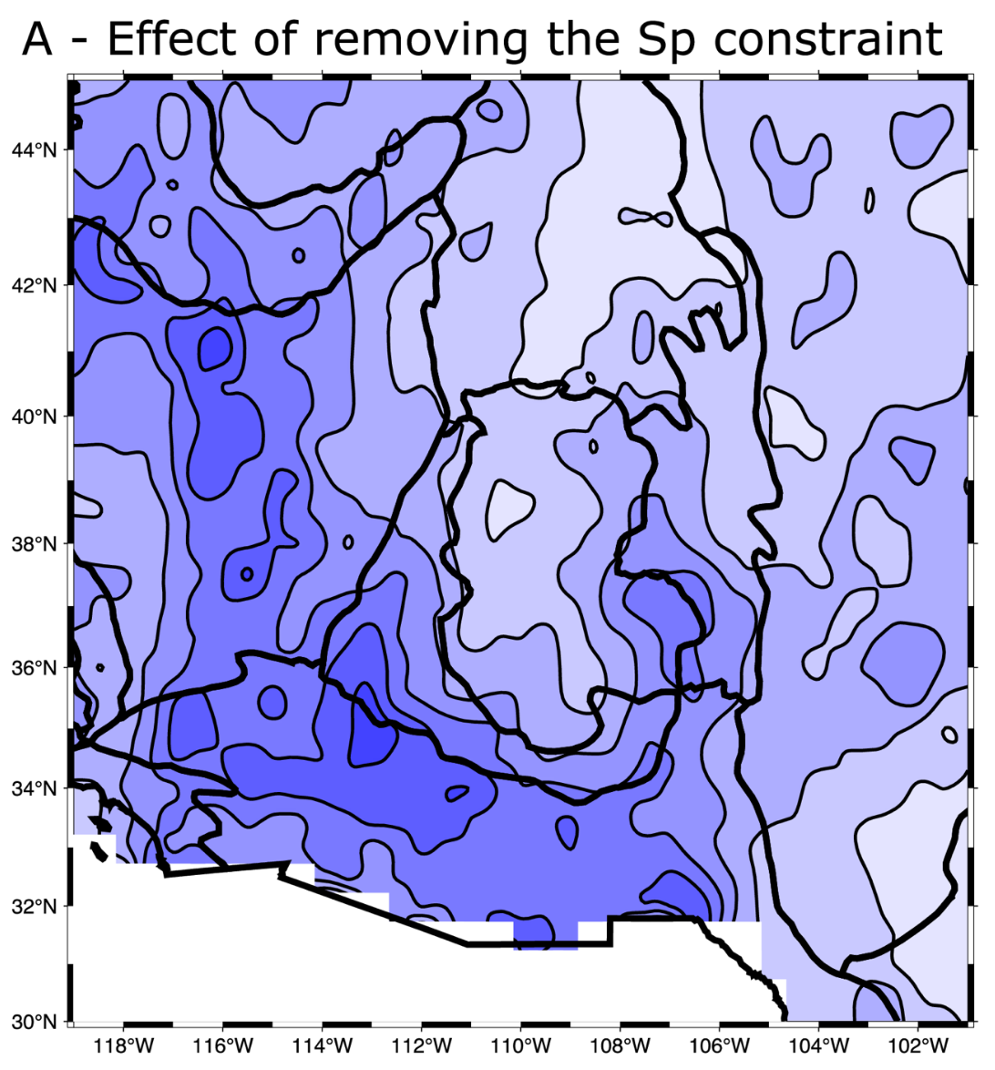
- Where is there melt in the asthenosphere?
Used the Very Broadband Rheology Calculator (Havlin et all., 2021) to test the hypothesis that Vs below the NVG can be
explained by 1)temperature 2) grain size using priors based on basalt thermobarometers and xenolith data.
Two different predictions for Vs from experimental data give 95% confidence intervals shown below

Slide 37
- Where is there melt in the asthenosphere?
Used the Very Broadband Rheology Calculator (Havlin et all., 2021) to test the hypothesis that Vs below the NVG can be
explained by 1)temperature 2) grain size using priors based on basalt thermobarometers and xenolith data.
Two different predictions for Vs from experimental data give 95% confidence intervals shown below

Slide 38
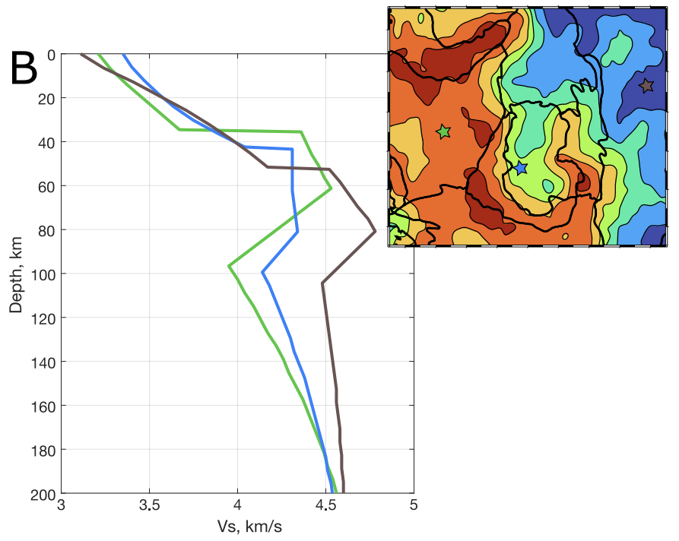
- Where is there melt in the asthenosphere?
Steeper slopes below the LAB where velocity is low
Independent observation
- 0.9 correlation coefficient (very high)

Slide 39
- Where is there melt in the asthenosphere?
Steeper slopes below the LAB where velocity is low
Independent observation
- 0.9 correlation coefficient (very high)

Slide 40
- Where is there melt in the asthenosphere?
melt fraction, %
~1%
LAB
Depth, km
LAB + 50 km

Slide 41
- Where is there melt in the asthenosphere?
melt fraction, %
~1%
LAB
Depth, km
LAB + 50 km

Slide 42
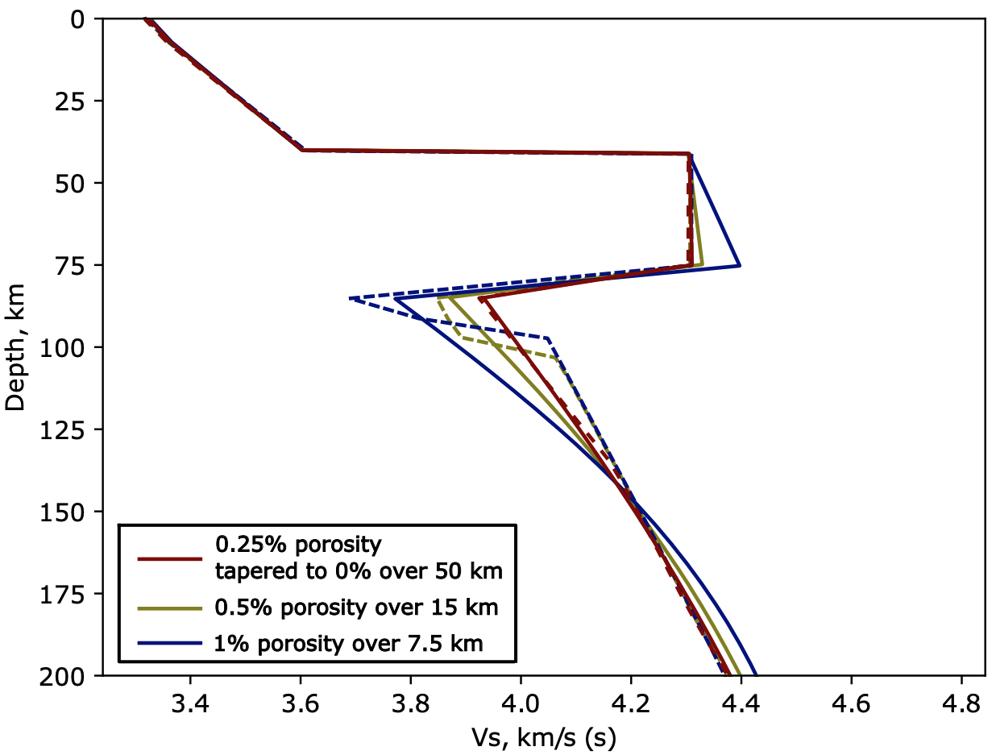
- Where is there melt in the asthenosphere?
Can’t be too specific on the details
melt fraction, %
~1%
LAB
Depth, km
LAB + 50 km

Slide 43
- How is the distribution of volcanism related to
hot asthenosphere?
Green dots are Pleistocene or younger volcanism from NAVDAT
Nearly all volcanism occurs where we infer melt with >95% confidence
- In fact, there is melt present over wide regions where there is no known recent volcanism
Only two exceptions:
Leucite Hill
Raton Clayton (partly crosses the boundary)

Slide 44
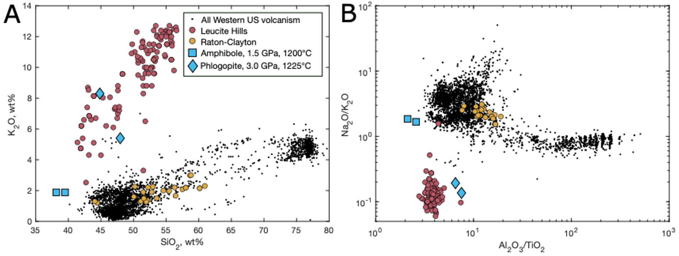
- How is the distribution of volcanism related to
hot asthenosphere?
Compositions
Composition ratios

Slide 45
- How is the distribution of volcanism related to
hot asthenosphere?
Raton-Clayton lavas look pretty normal
Compositions
Composition ratios
Very close to the “melt required”
region

Slide 46
- How is the distribution of volcanism related to
hot asthenosphere?
Leucite Hills are ultrapotassic and furthest from “hot asthenosphere”
Compositions
Composition ratios
Clearly above an
“MLD”

Slide 47
Conclusions, Part 1:
How thick is the lithosphere?
LAB occurs at 60-80 km depth except beneath beneath the Wyoming Craton
and stable North America, where the LAB may be much deeper.
Where is there melt in the asthenosphere?
Melt is confidently identified across the Basin and Range province and
beneath the edges of the Colorado Plateau
- How is the distribution of volcanism related to hot asthenosphere?
Volcanism occurs above melt bearing asthenosphere with one major
exception, the ultrapotassic Leucite Hills.

Slide 48
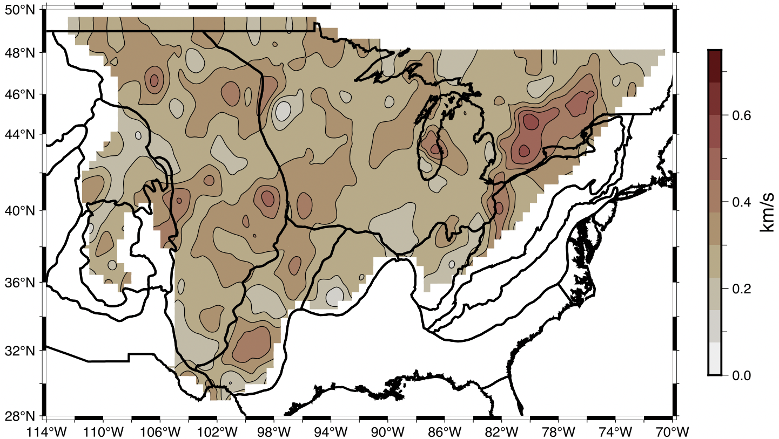
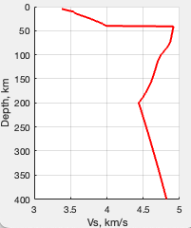
Ongoing research - Revisiting the continental moho
Jump in Vs across the moho in Shen and Ritzwoller, 2016
Used as a constraint for the mantle model I just discussed
Null hypothesis:
Globally average crust
Mantle on continental geotherm
ΔVs=0.7-9 km/s

Slide 49
Ongoing research - Revisiting the continental moho
Jump in Vs across the moho in Shen and Ritzwoller, 2016
Used as a constraint for the mantle model I just discussed
Null hypothesis:
Globally average crust
Mantle on continental geotherm
0.9
ΔVs=0.7-9 km/s
0.7

Slide 50
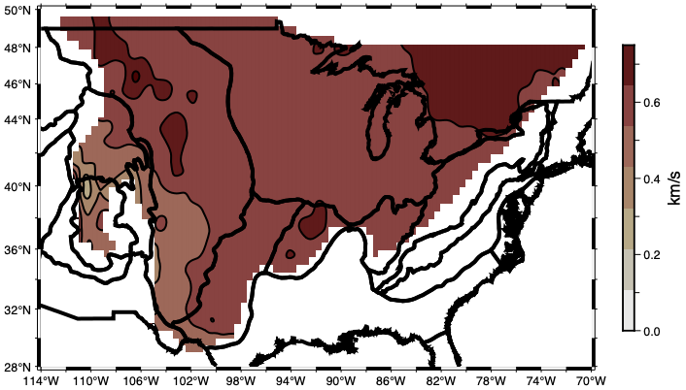
Ongoing research - Revisiting the continental moho
Null hypothesis:
Globally average crust
Mantle on continental geotherm
ΔVs in Crust 1.0 – it’s not just the null hypothesis that’s off
0.9
ΔVs=0.7-9 km/s
0.7

Slide 51
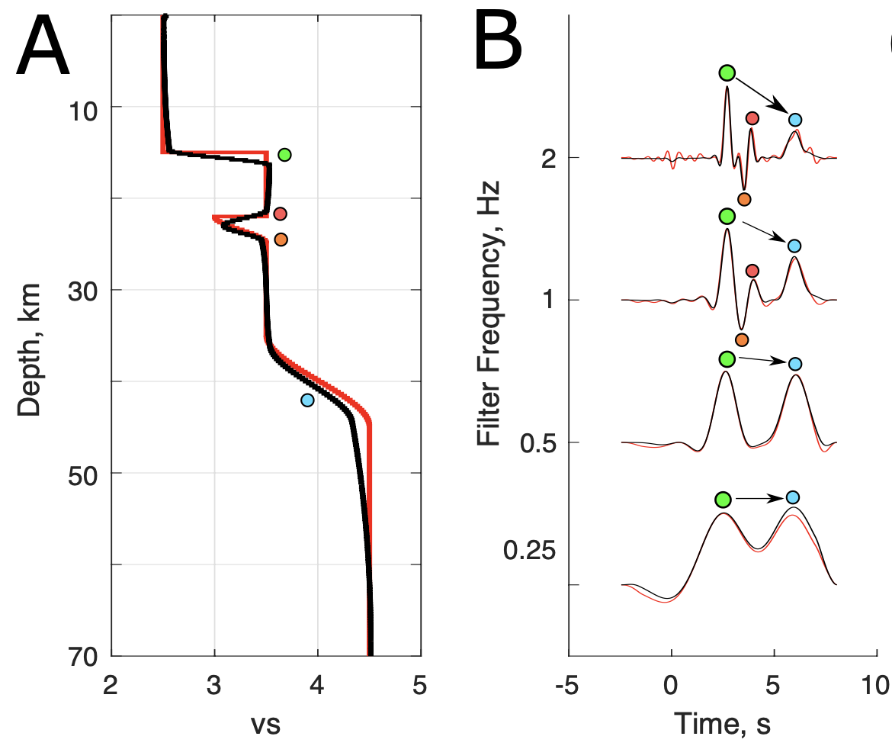
Future research directions Why care about the velocities at the moho?
Test of a new inversion with “adaptive mesh refinement”
and much higher frequency data (ie, better depth resolution)
Black recovered, red synthetic. Appears to work!
Current
generation
of models

Slide 52
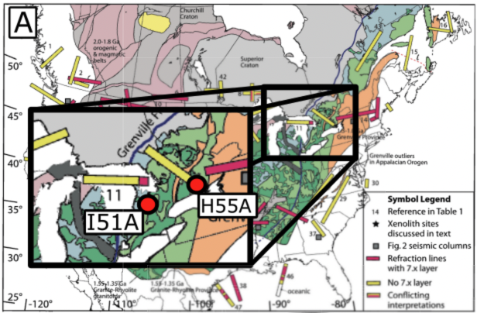
Early results
Two sites in the north-eastern United States
from Schulte—Pelkum et al., 2017

Slide 53
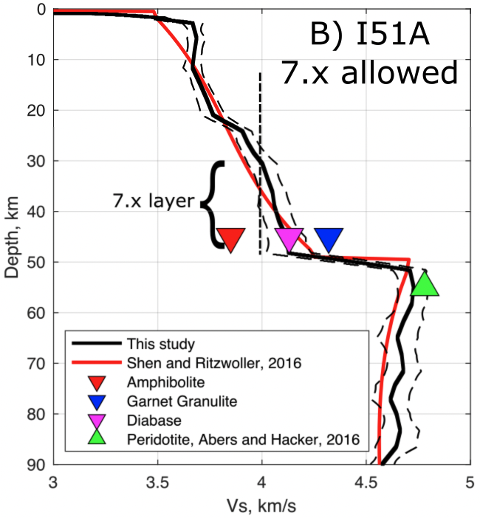
Early results
Two sites in the north-eastern United States
from Schulte—Pelkum et al., 2017

Slide 54
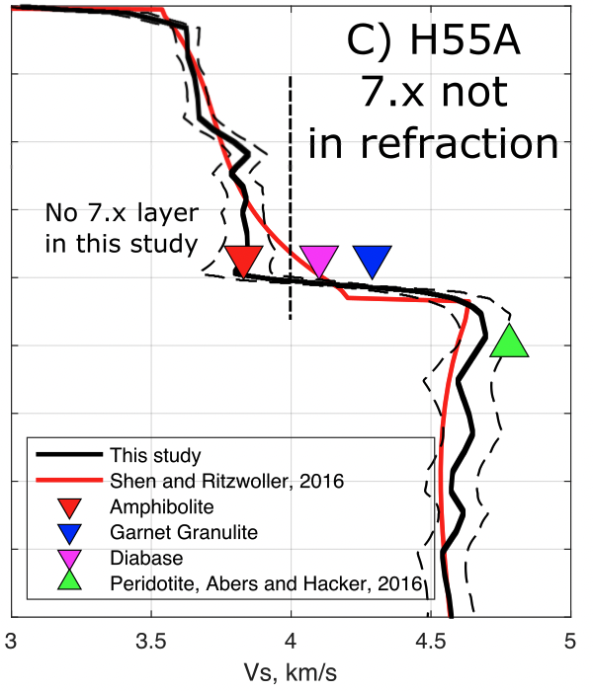
Early results
Two sites in the north-eastern United States
from Schulte—Pelkum et al., 2017

Slide 55
Early results
Two sites in the north-eastern United States
from Schulte—Pelkum et al., 2017

Slide 56
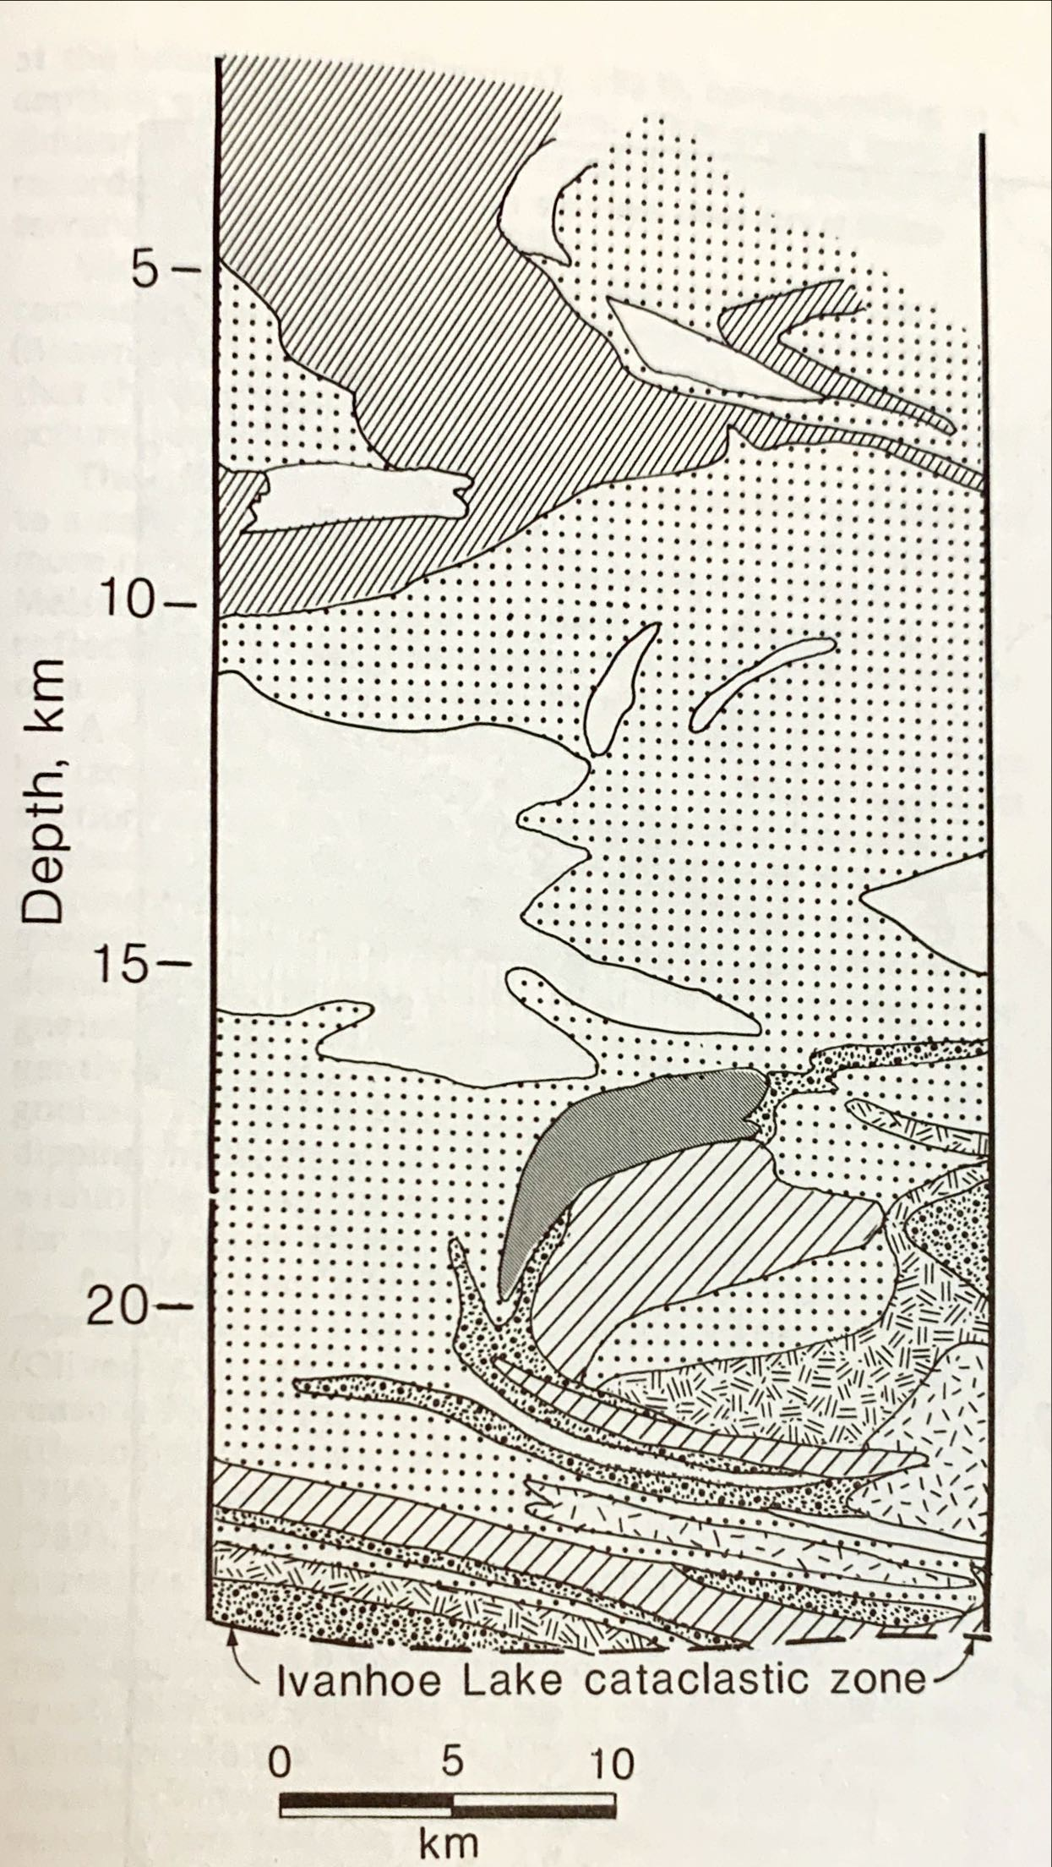
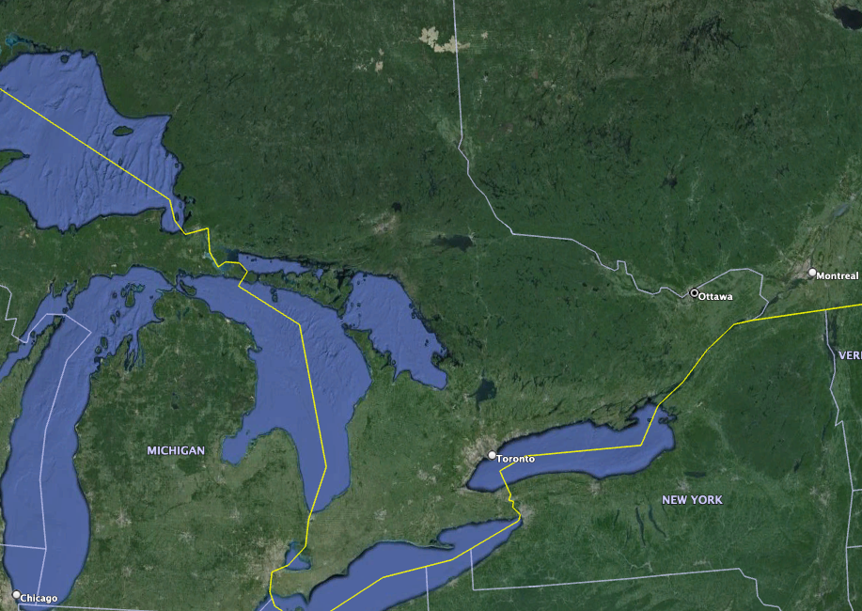
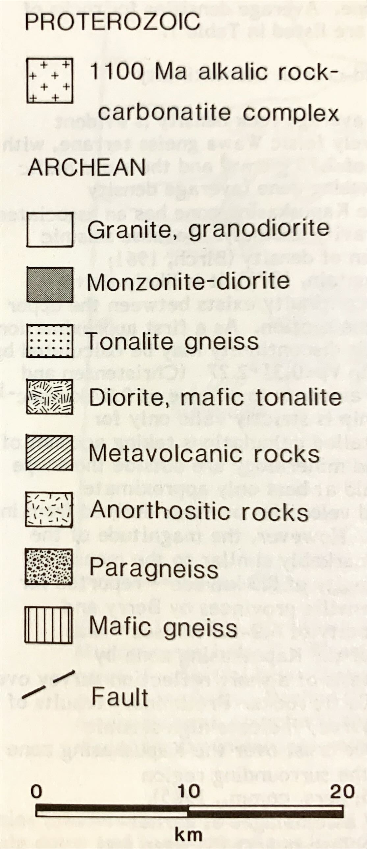
Early results
Percival, 1986
Kapuskasing Mid-crustal Exposure
H55A

Slide 57
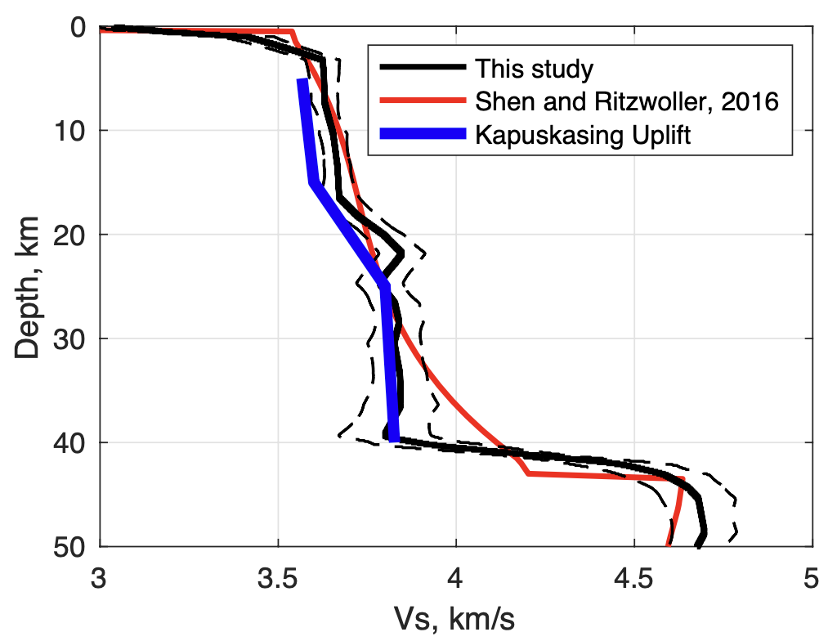
Early results
The Kapuskasing uplift does a very good job
forward modeling the lower crust
- without a transition to a more mafic 3rd layer
“Conrad”
discontinuity

Slide 58
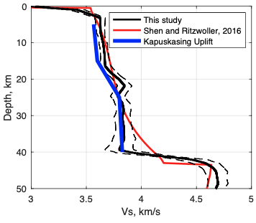
Thank you and questions
Low velocities correlate with
volcanoes in the western US
In-situ melt is needed to explain
the seismic velocities
Opens an opportunity to
look at the composition of
continental crust

