Slide 1
Evidence for the alignment of melt in the mantle beneath mid-ocean ridges from teleseismic shear-wave splitting
DI12A Exploring Complex Mantle Dynamics with Observations, Laboratory Experiments, and Computer Models II Oral
Presented by Joseph Byrnes¹
with James Gaherty¹, Eric Loeberich², Maureen Long², and Songqiao Shawn Wei³
¹ Northern Arizona University, ² Yale University, ³Michigan State University

Slide 2
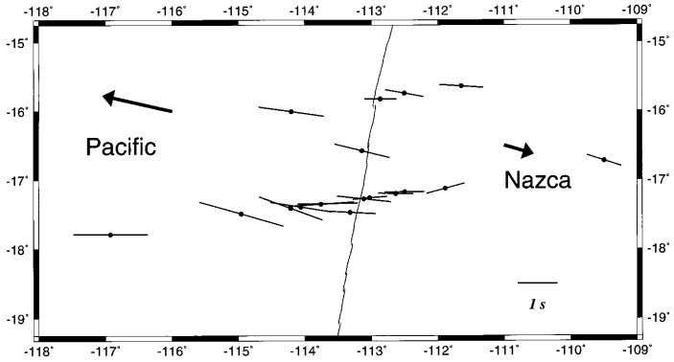
Azimuthal anisotropy at mid-ocean ridges axes – strong or weak splitting?
Olivine aligned by mantle flow?
Southern East Pacific Rise: MELT experiment
Wolfe and Solomon, 1998
Signature - ”normal” splitting times
weaker or similar right at the ridge axis
Informs us about mantle flow

Slide 3
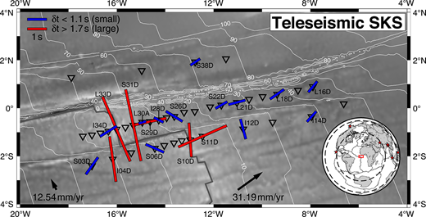
Azimuthal anisotropy at mid-ocean ridges axes – strong or weak splitting?
Olivine aligned by mantle flow?
Melt aligned in the mantle?
Southern East Pacific Rise: MELT experiment
Mid-Atlantic ridge: PI-LAB experiment
Wolfe and Solomon, 1998
Kendall et al., 2023
Signature - ”normal” splitting times
weaker or similar right at the ridge axis
Informs us about mantle flow
Signature – large splitting times
stronger right at the ridge axis
Informs us about melt migration dynamics

Slide 4
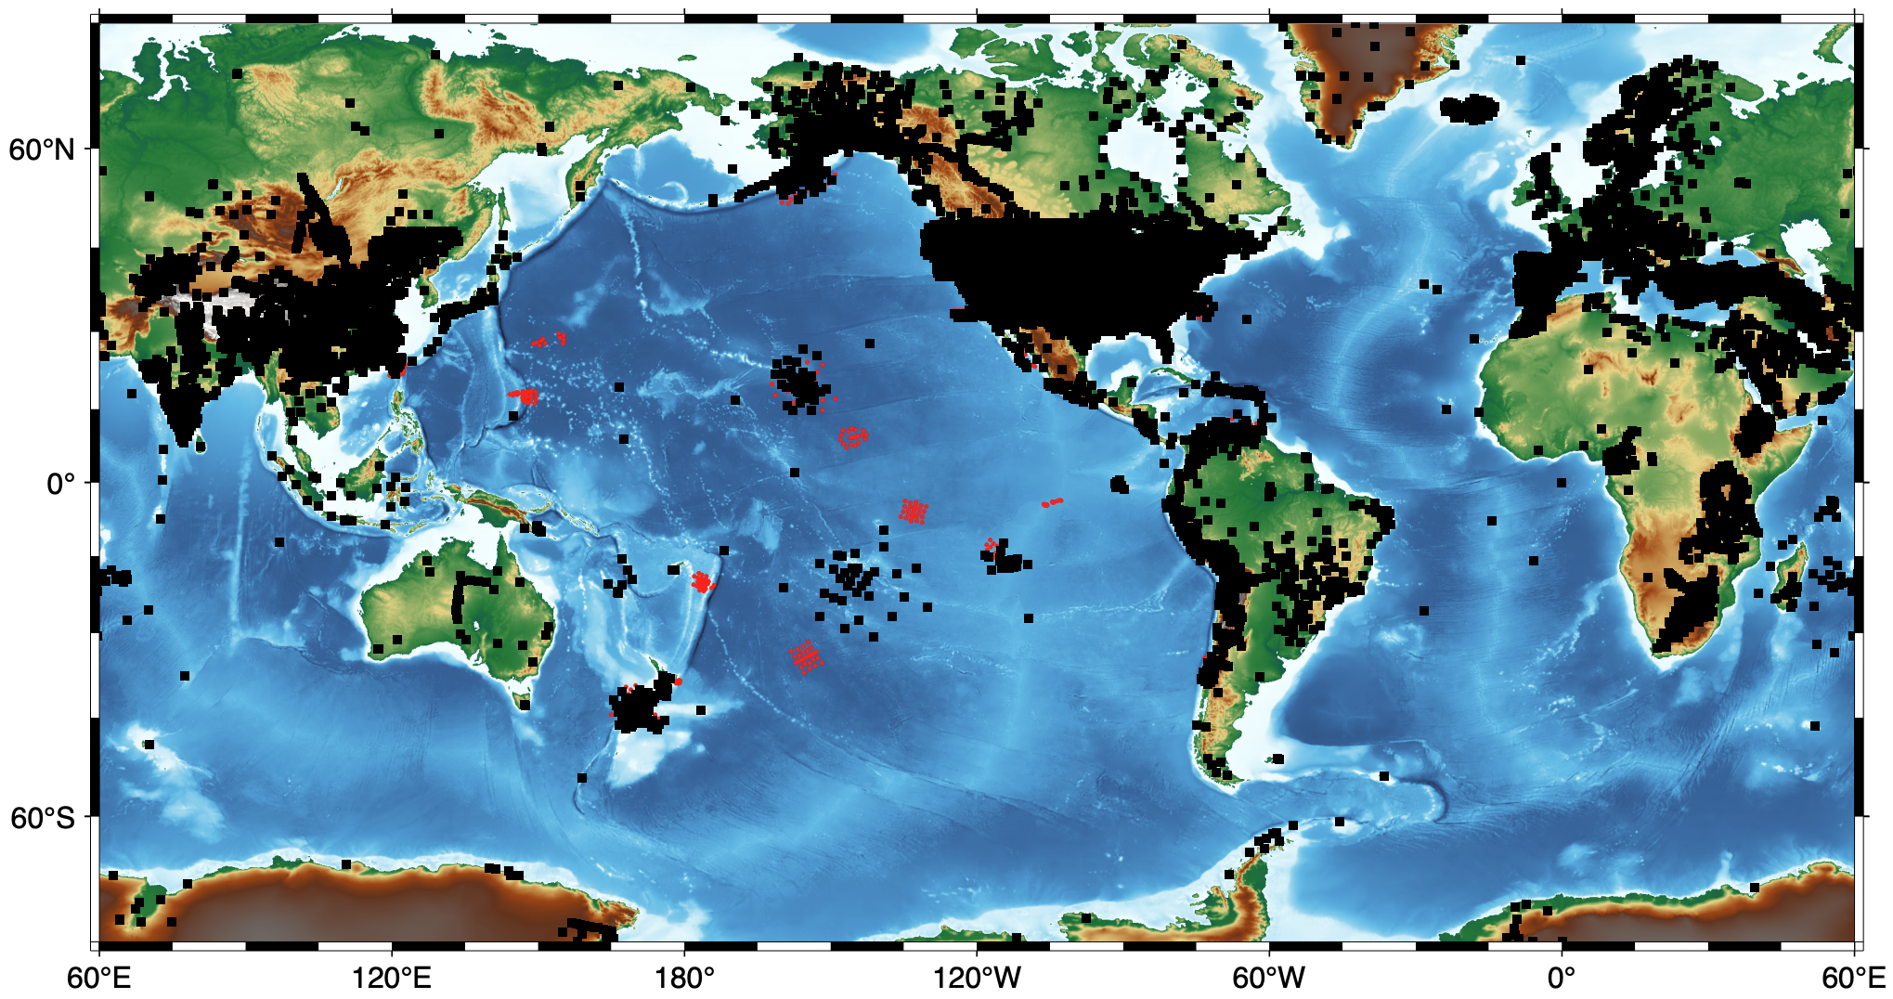
Opportunity with existing datasets - SKS splitting in the oceans is very hard
Black squares
Site where SKS, SKKS splitting is collected in the regularly updated databases of
Becker et. (2012)
Wüstefeld et al.'s (2009)
Red circles
Broad band ocean bottom seismometers
OBSIP/OBSIC deployments only
Masked if splitting was reported

Slide 5
Opportunity with existing datasets - SKS splitting in the oceans is very hard
Black squares
Site where SKS, SKKS splitting is collected in the regularly updated databases of
Becker et. 2012
Wüstefeld et al.'s (2009)
Lau Basin experiment
is the focus here

Slide 6
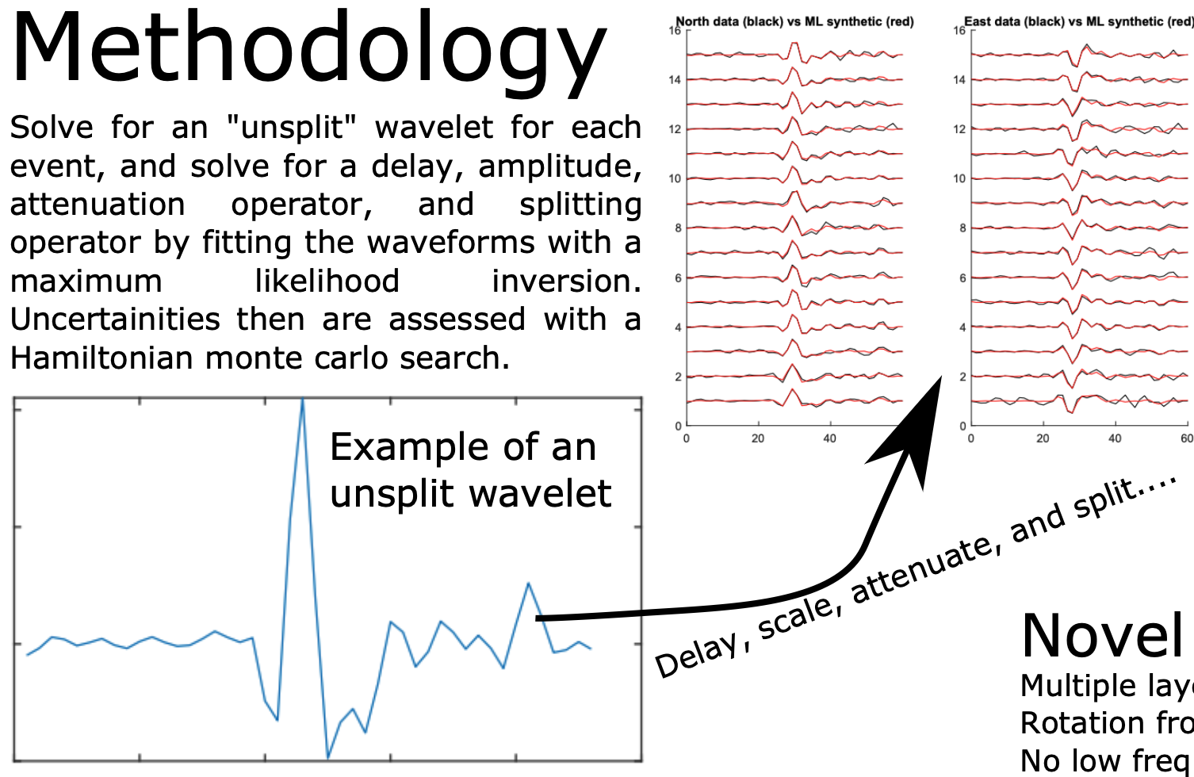
Approach to SKS splitting at low
signal to noise ratios
Directly invert for splitting parameters by
fitting waveforms over multiple events
- following Menke and Levin, 2003
2. Solve for a source-time function for each
event, and convolve with the splitting operator
to make the synthetic waveforms, with appropriate
covariance matrix for fitting
Byrnes and Gaherty, in prep

Slide 7
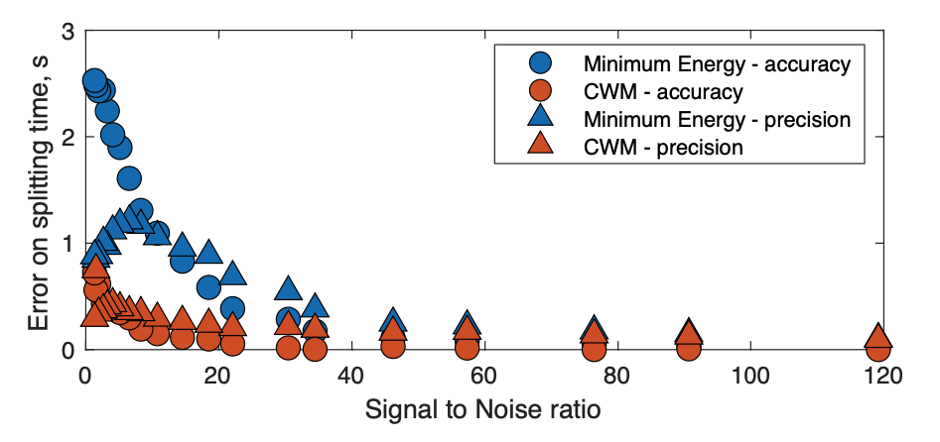
Approach to SKS splitting at low
signal to noise ratios
Directly invert for splitting parameters by
fitting waveforms over multiple events
- following Menke and Levin, 2003
2. Solve for a source-time function for each
event, and convolve with the splitting operator
to make the synthetic waveforms, with appropriate
covariance matrix for fitting
Byrnes and Gaherty, in prep

Slide 8
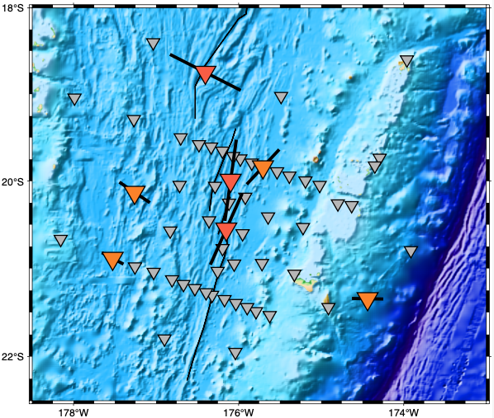
Lau Basin results – splits are larger on axis
Mean on-minus-off-axis splitting time = 0.8s
For context: global average is 1 s
Stations without results due to noise
in all 6 events considered
Stations within 50 km of a ridge
- Splitting times range from 1.75 to 1.9 s
Stations further than 50 km from a ridge
- Splitting times range from 0.6 to 1.05 s

Slide 9
Lau Basin results – splits are larger on axis
Mean on-minus-off-axis splitting time = 0.8s
For context: global average is 1 s
Red: Tangential waveform at C09W (highlighted)
Blue: Best fitting transverse from the inversion
Black line is best fitting waveform
with a mean the off-axis split (~0.8 s)
Significantly degraded fit to red

Slide 10
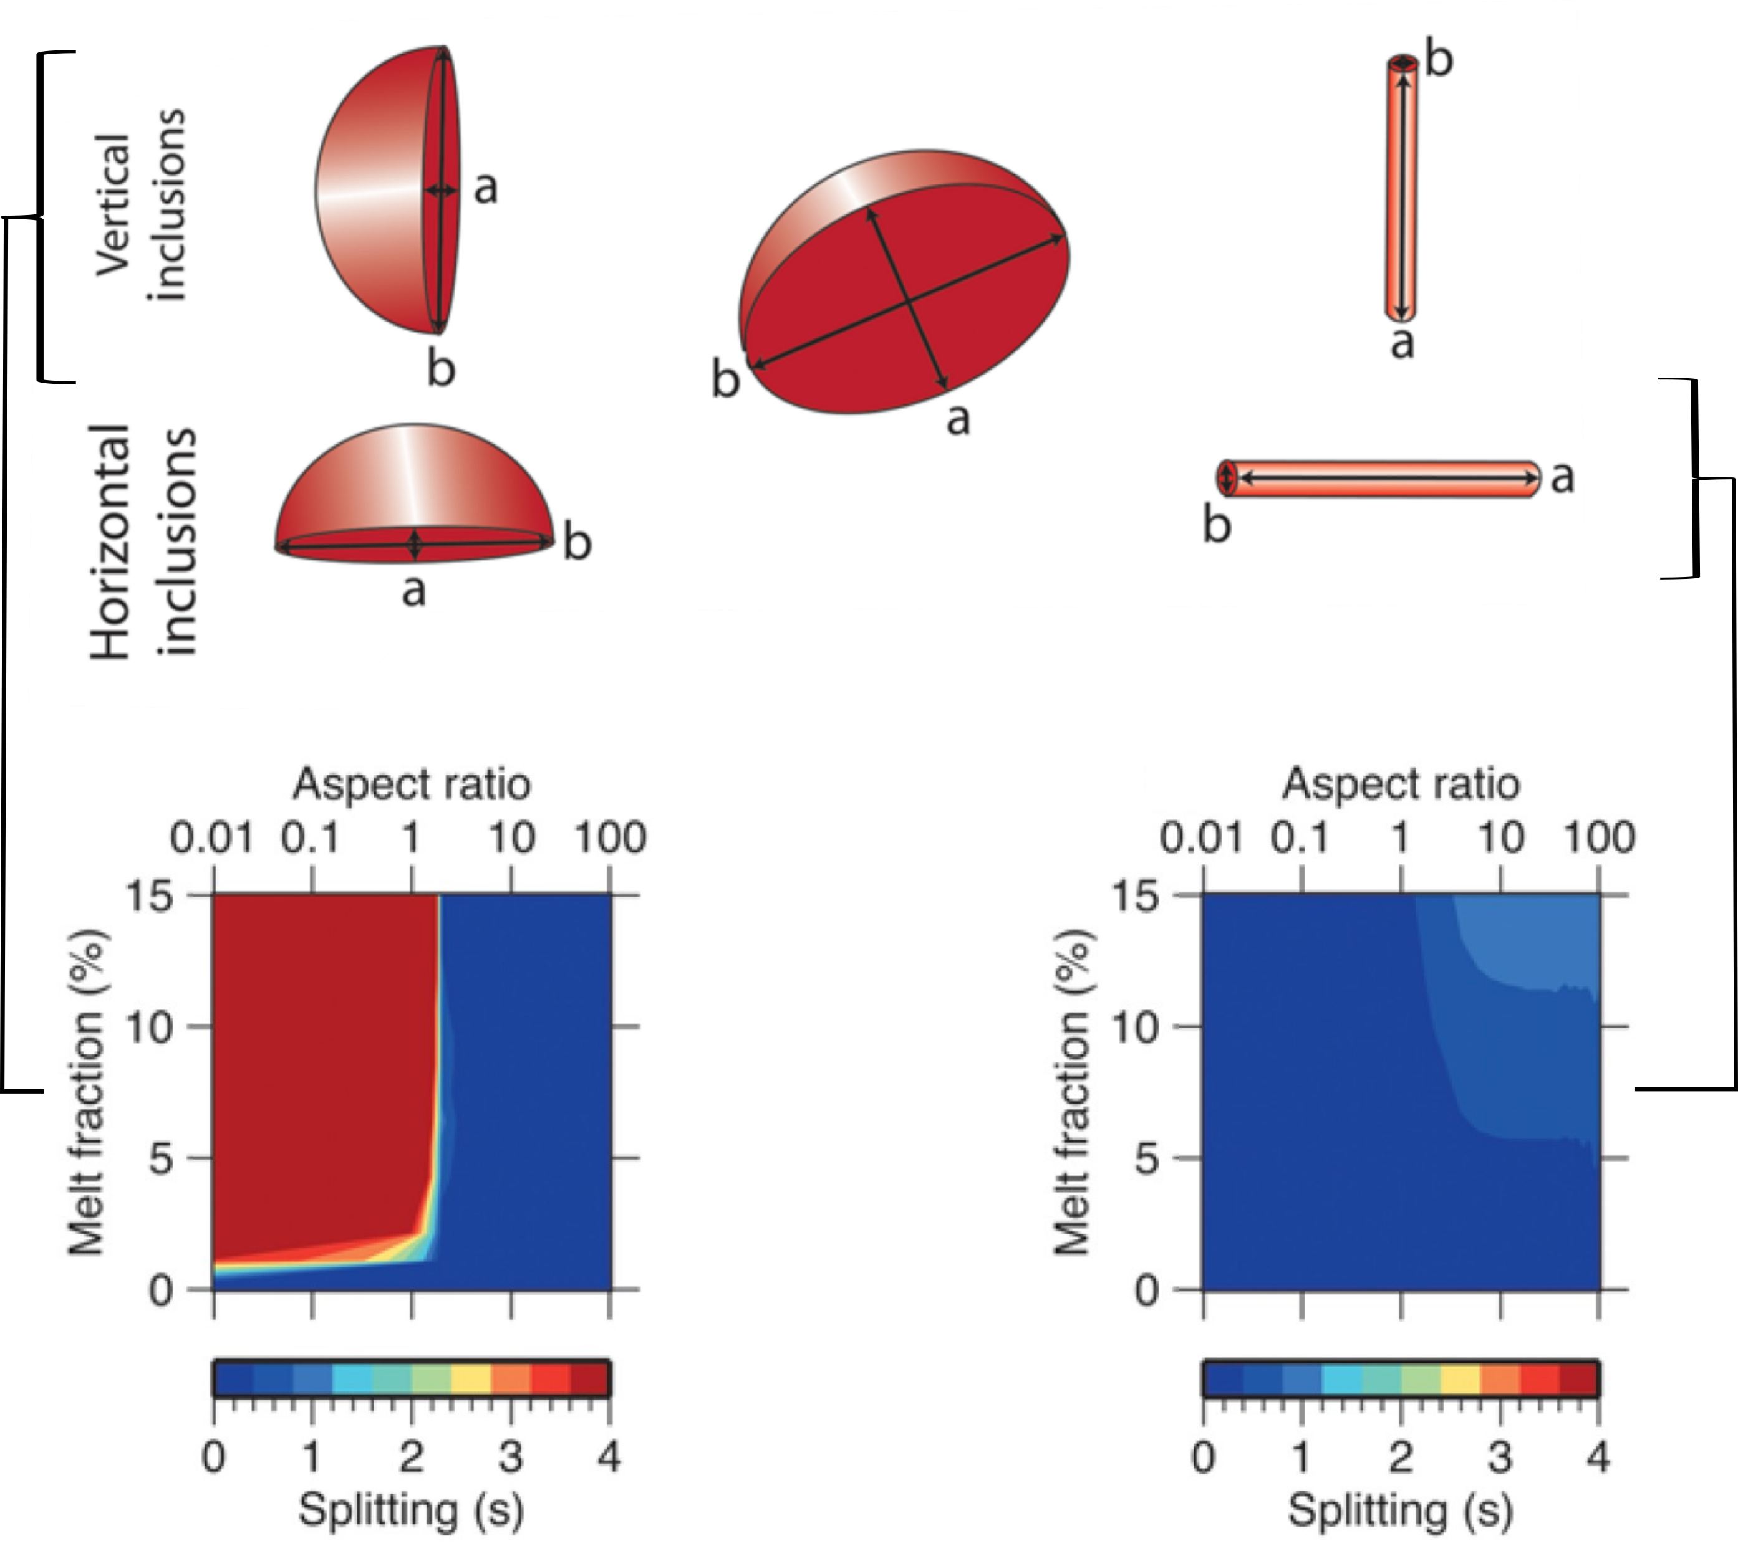
Larger splits are melt?
- Lau probably can’t allow ~200 km thick column of coherent anisotropy,
can melt inclusions explain high δt on axis and sharp transitions?
- find Eric Loeberich’s at poster DI43C-0060 (Thursday, 2:10 PM - 6:30)
for waveform simulations.
E-type
E-type & Melt
0.8 s increase over short distances
predictable with waveform simulations
Hammond and Kendall (2016)

Slide 11
Conclusions
SKS splitting with ocean-bottom seismometers can be improved with a new computational approach.
Splitting times are ~0.8 s larger within 50 km of the backarc ridge axis than greater than 50 km away
Such a large increase in splitting times is consistent with aligned melt in the upper mantle.
Stations with large splitting

Slide 12
Supplemental slides

