Slide 1
Accelerated transdimensional MCMC for differentiable problems with Riemann manifold based proposals
NG22A Advances in Data Assimilation, Predictability, and Uncertainty Quantification II
Presented by Joseph Byrnes¹
¹ Northern Arizona University

Slide 2
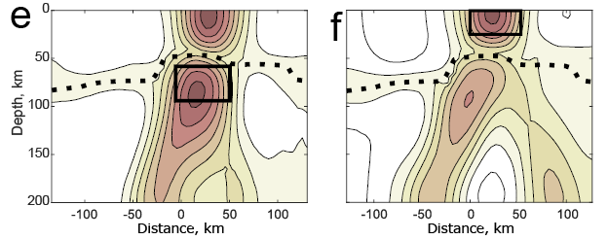
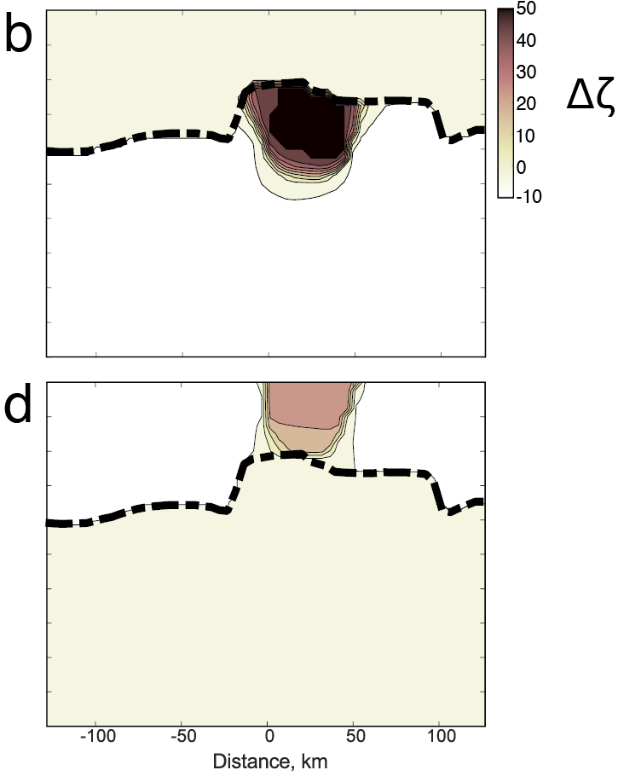
“Transdimensional” monte carlo simulations can be necessary
Damped least squares solution
Above and
below the
dashed line
Byrnes and Bezada, 2020

Slide 3
“Transdimensional” monte carlo simulations can be necessary
Damped least squares solution
Transdimensional Monte Carlo
Above and
below the
dashed line
Clean separation (with uncertainties)
Byrnes and Bezada, 2020

Slide 4
Can we speed transdimensional inversions up?
Computation time <0.1 s in MATLAB
Computation time >24 hours in MATLAB
Above and
below the
dashed line
Clean separation (with uncertainties)
Byrnes and Bezada, 2020

Slide 5
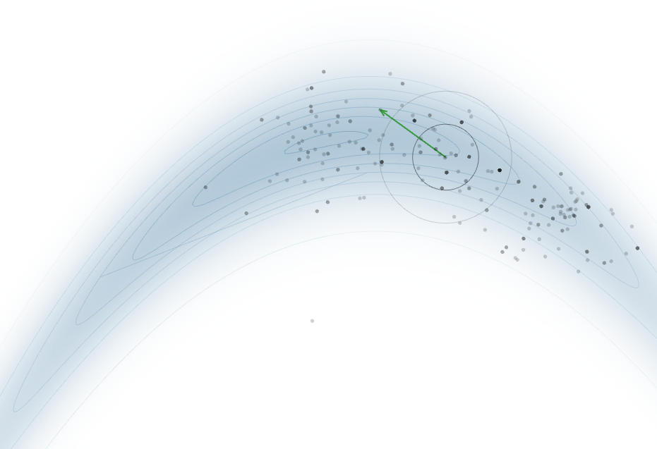
Many monte carlo tricks don’t work in the transdimensional case
Random walk monte carlo
Demos from https://chi-feng.github.io/mcmc-demo/

Slide 6
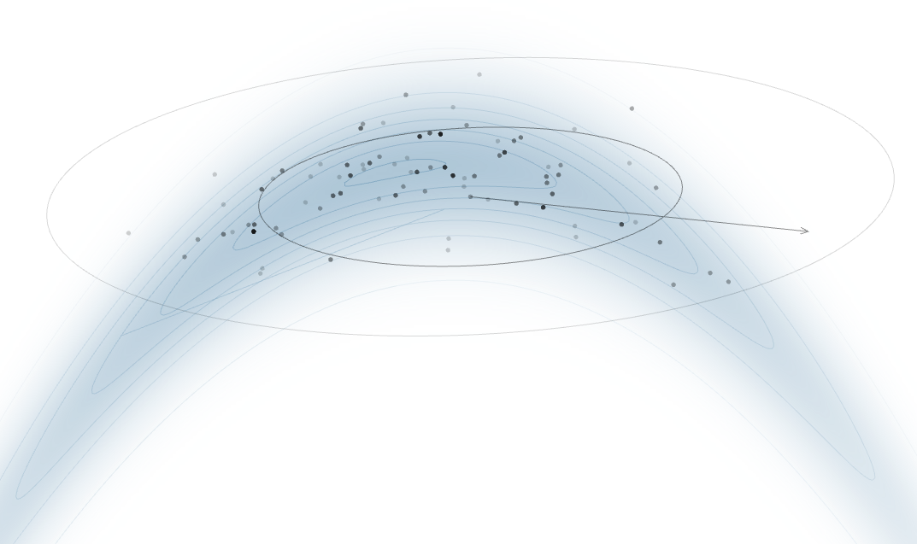
Many monte carlo tricks don’t work in the transdimensional case
Random walk monte carlo
“Adaptive” monte carlo
“Adaptive” monte carlo
Demos from https://chi-feng.github.io/mcmc-demo/

Slide 7
Many monte carlo tricks don’t work in the transdimensional case
Random walk monte carlo
“Adaptive” monte carlo
This is (nearly) impossible if the
dimensions are changing!
Demos from https://chi-feng.github.io/mcmc-demo/

Slide 8
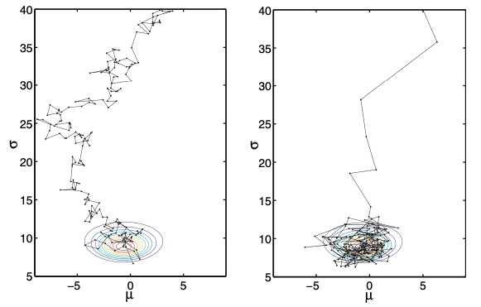
Possible solution – the perfect scaling can be calculated if you have first derivatives
Logic from Girolami and Calderhead, 2013
First conceptual change
- the “distance” between two states is given by the Fischer Information Matrix (entirely composed of first derivatives)
- This matrix gives the perfect scaling for all parameters, with covariances. Note the length of the line in the toy problem to the left.
- Once you have the derivatives, might as well add gradient descent into the search
“Riemann manifold”
monte carlo
Unscaled Monte carlo

Slide 9
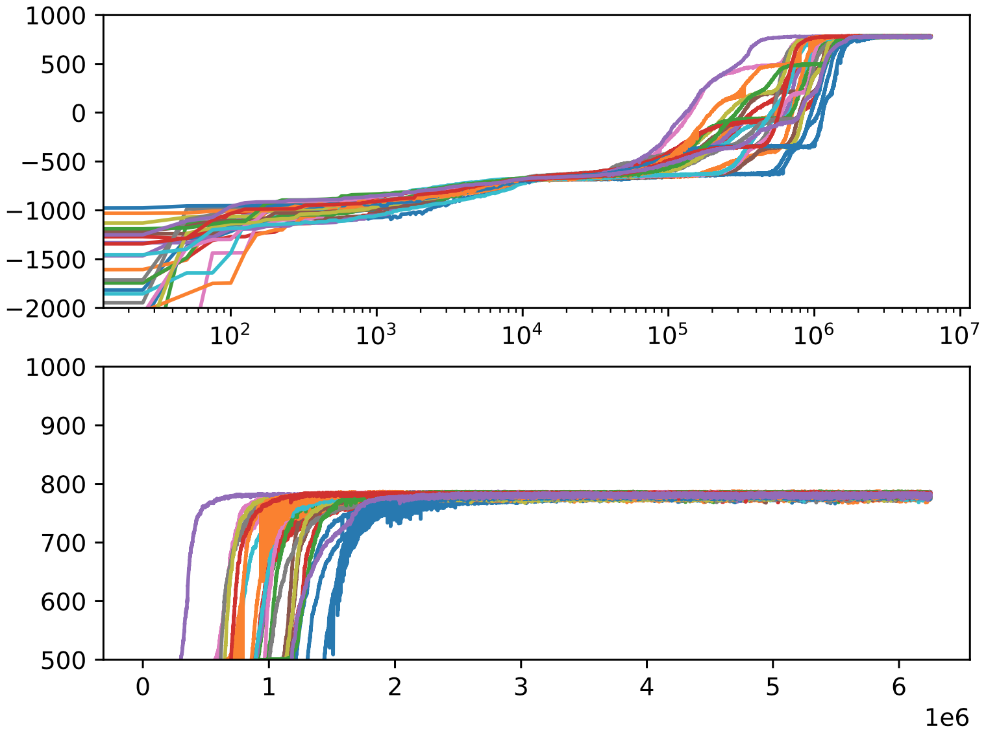
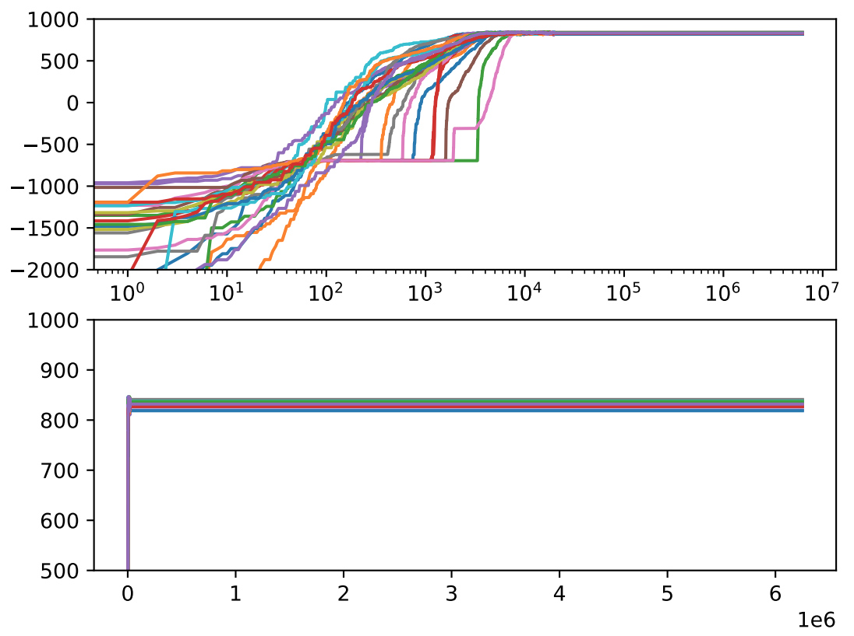
Toy problem demonstration – Reconstructing a sum of exponentials: y = $\sum_{1}^{k}{a_{k}x^{b_{k}}}$
Riemann manifold search – 300x speed up
(6000x considering extra runs for parallel tempering)
Metropolis search with parallel tempering
(Log-likelihood + log-prior)
Iterations
Iterations

Slide 10
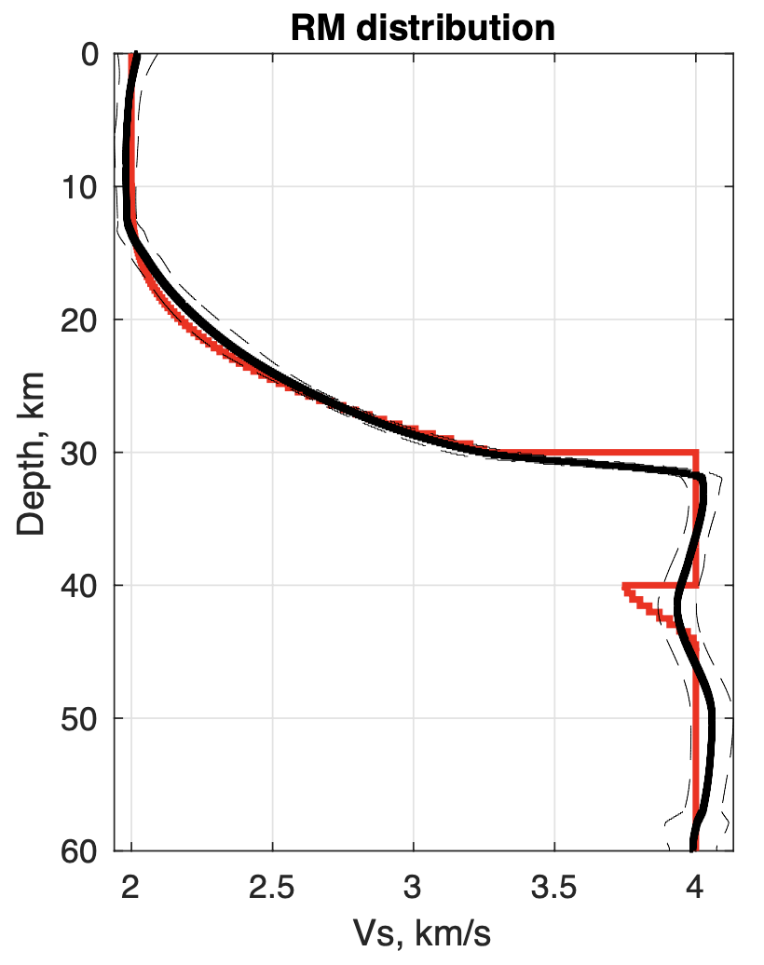
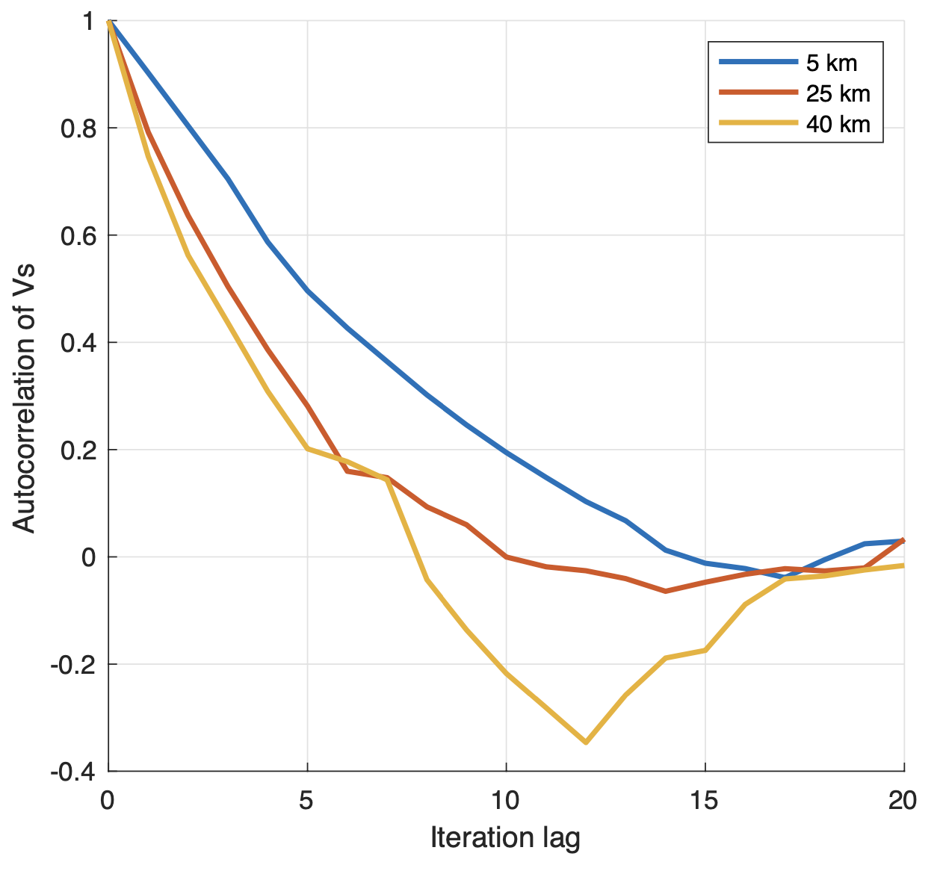
Limitation and a solution with a real seismic imaging problem
Joint inversion of surface wave and receiver function data
- Problem: Monte carlo chains must be reversible. Far from the solution, quasi-Newton methods can fail. This technique is a quasi-Newton method.
So a pre-optimization step may be necessary. (The abstract claims a different solution; but pre-optimization is much more effective).
Red – synthetic input
used to make noisy
synthetic data
Black – mean of
the MCMC with 95%
error
5-15 samples for independence
>1000 for a random walk

Slide 11
Conclusions
Girolami and Calderhead, 2013’s monte carlo techniques translate nicely to the transdimensional case and enhance the use of gradients.
Enormous acceleration is possible without needing to tune the proposals.
Realistic, non-linear problems experience trouble with reversibility of the chains to maintain detailed balance. Preoptimization is a potential way forward.
1. Riemann methods also generalize to the Hamiltonian monte carlo method, also generalizable to the transdimensional case – see Sen and Biswas, 2017
2. Higher dimensional problems could become possible with accurate covariance estimates.
3. Parallel tempering modifies the Fischer information matrix to expand the search space for tempered models and should be explored more.
Future directions

Slide 12
Supplemental slides

Slide 13
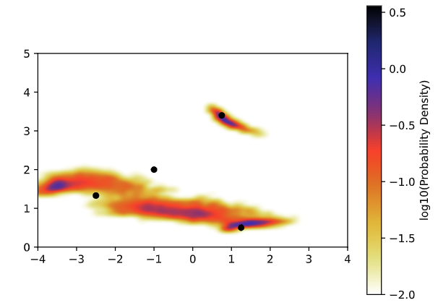
Toy problem demonstration
Transdimensional toy problem with extreme nonlinearity and parameter covariance.
Target model is
y = 0.75*x^3.4 – x^2.0 + 1.25*x^0.5 - 2.5*x^1.33
then the models I search over are
y = $\sum_{1}^{k}{a_{k}x^{b_{k}}}$
where the model vector is [ a₁ … a_{k} ln(b₁) … ln(b_{k}) ln(σ) ]. The number of terms, k, and the data error, σ, are both treated as unknowns.
PDF of solutions – very non-unique!
True answer is 4
b
PDF of the # of summed terms
a

